Slide 1
SUSTAINABLE FARMING Top Soil & Groundwater
2015 Year of Soils
50 years of little attention for soil life and organic matter.
Farmers, water boards, drinking water companies, nature orgs, citizens, all need fresh water, healthy food, climate resilience, all depending on good soil
Develop, test and use practical tools to improve soil & water quality and quantity

Slide 2
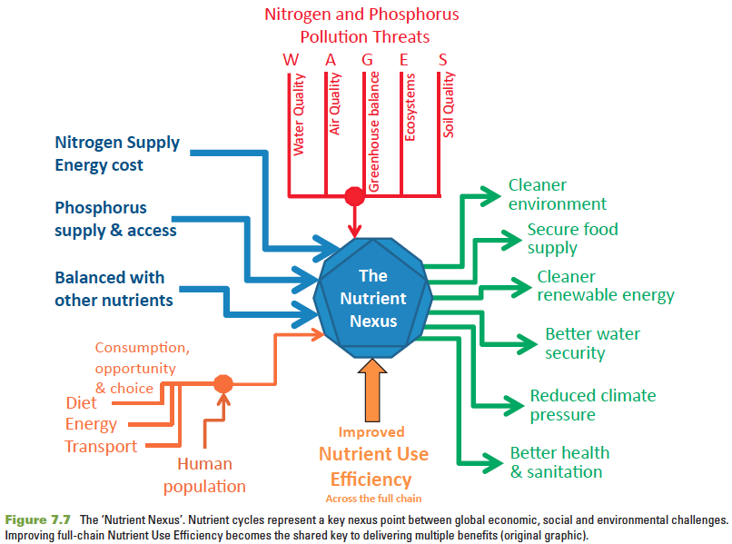

Slide 3
Our goal is to reach food production in balance with the eco system
Develop, test and use practical methods for farmers
Optimize efficient use of nutrients and water
Better understanding between land management and water management (integration)
Cooperation between farmers, scientists, society and industry (chain approach)

