Slide 1


Slide 2
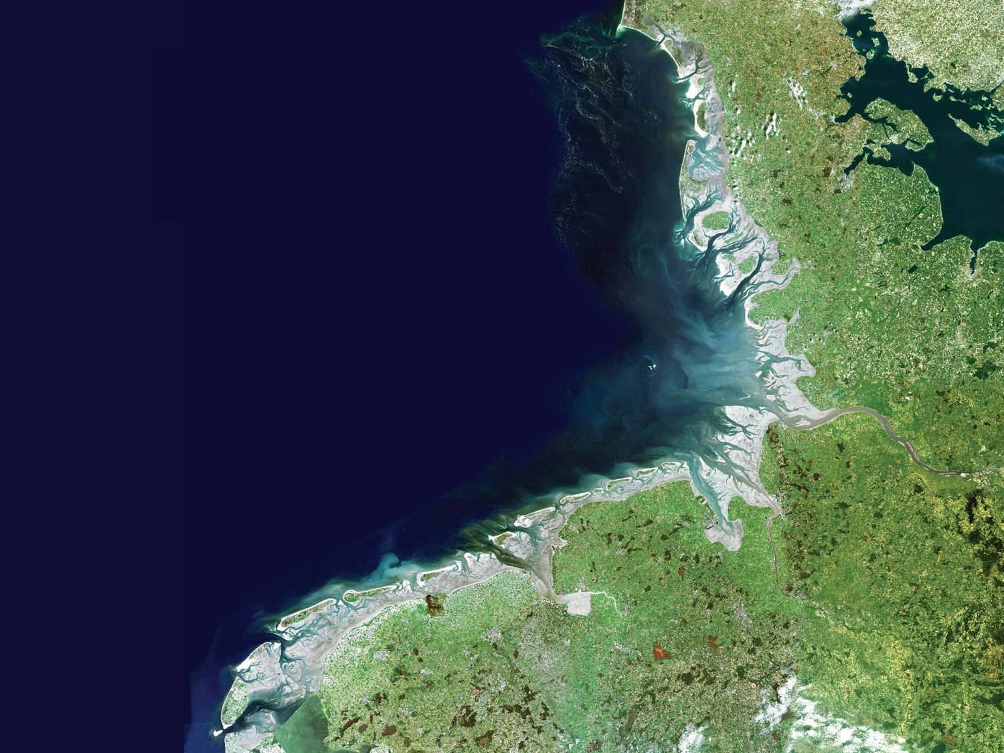
World Heritage Site Wadden Sea
“Protect and Prosper –
my benefits of World Heritage”

Slide 3
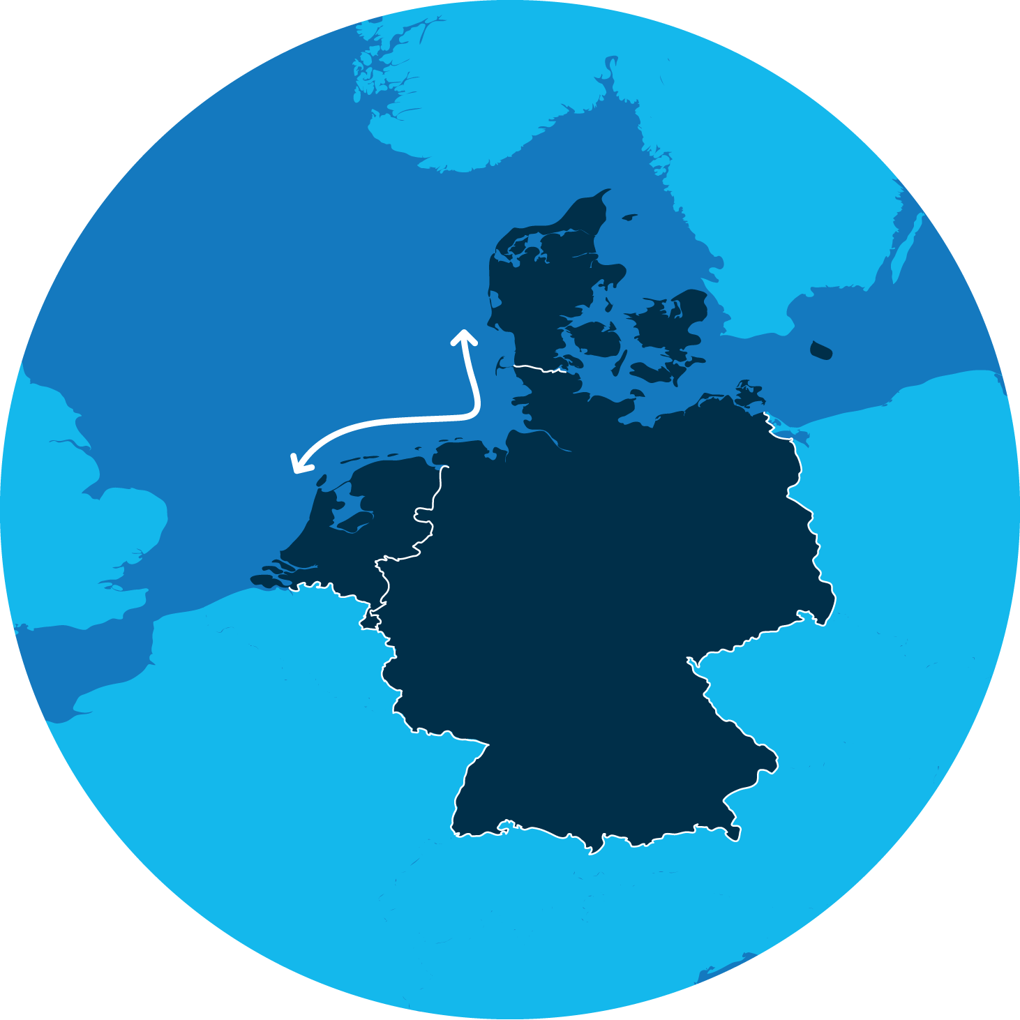
Welcome to
The Wadden Sea
500 km coastline
Denmark
The Netherlands
The Wadden Sea is a place like no other:
The largest unbroken system of intertidal sand and mud flats in the world, stretching for 500km across the northern coastline of three countries – Germany, Netherlands and Denmark.
Germany

Slide 4

Importance of UNESCO World Heritage status
World Heritage status is the most prestigious award for natural and cultural heritage.
World Heritage properties present new opportunities for the tourism sector. They are important travel destinations that
can have a positive impact for economic development and
long-term sustainability.
By communicating the importance and uniqueness of the Wadden Sea, we can build our global reputation and collective offer.

Slide 5
What does Outstanding Universal Value mean?
Outstanding Universal Value
is the cultural and/or natural significance, which is exceptional enough to transcend national boundaries and to be relevant and important to the global community, both now and in the future.
Outstanding
The unmatched excellence of the property.
Universal
The scope must be global, not national or regional.
Value
Defining the worth of the property and ranking its importance based on clear standards, including the integrity.

Slide 6
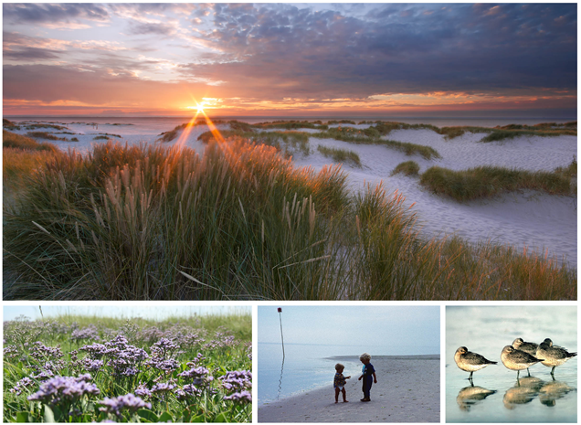
Criteria to assess global importance
Geology
Ecological processes
Biodiversity

Slide 7
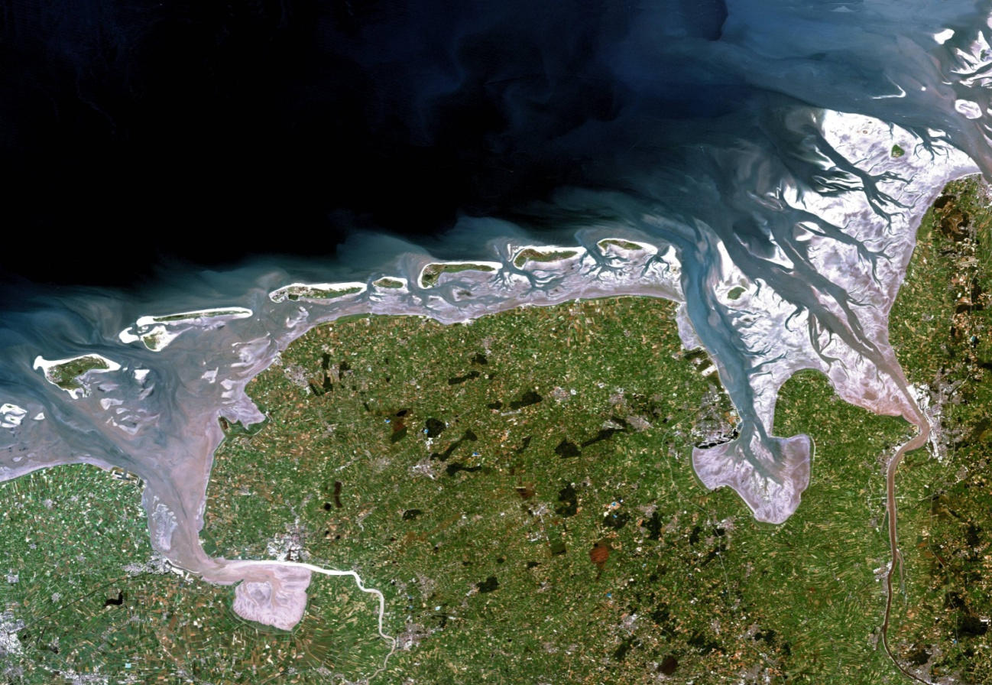
Criteria to assess global importance
Undisturbed geomorphological processes and dynamics
Young & dynamic habitats:
Islands
Mudflats
Coastlines

Slide 8
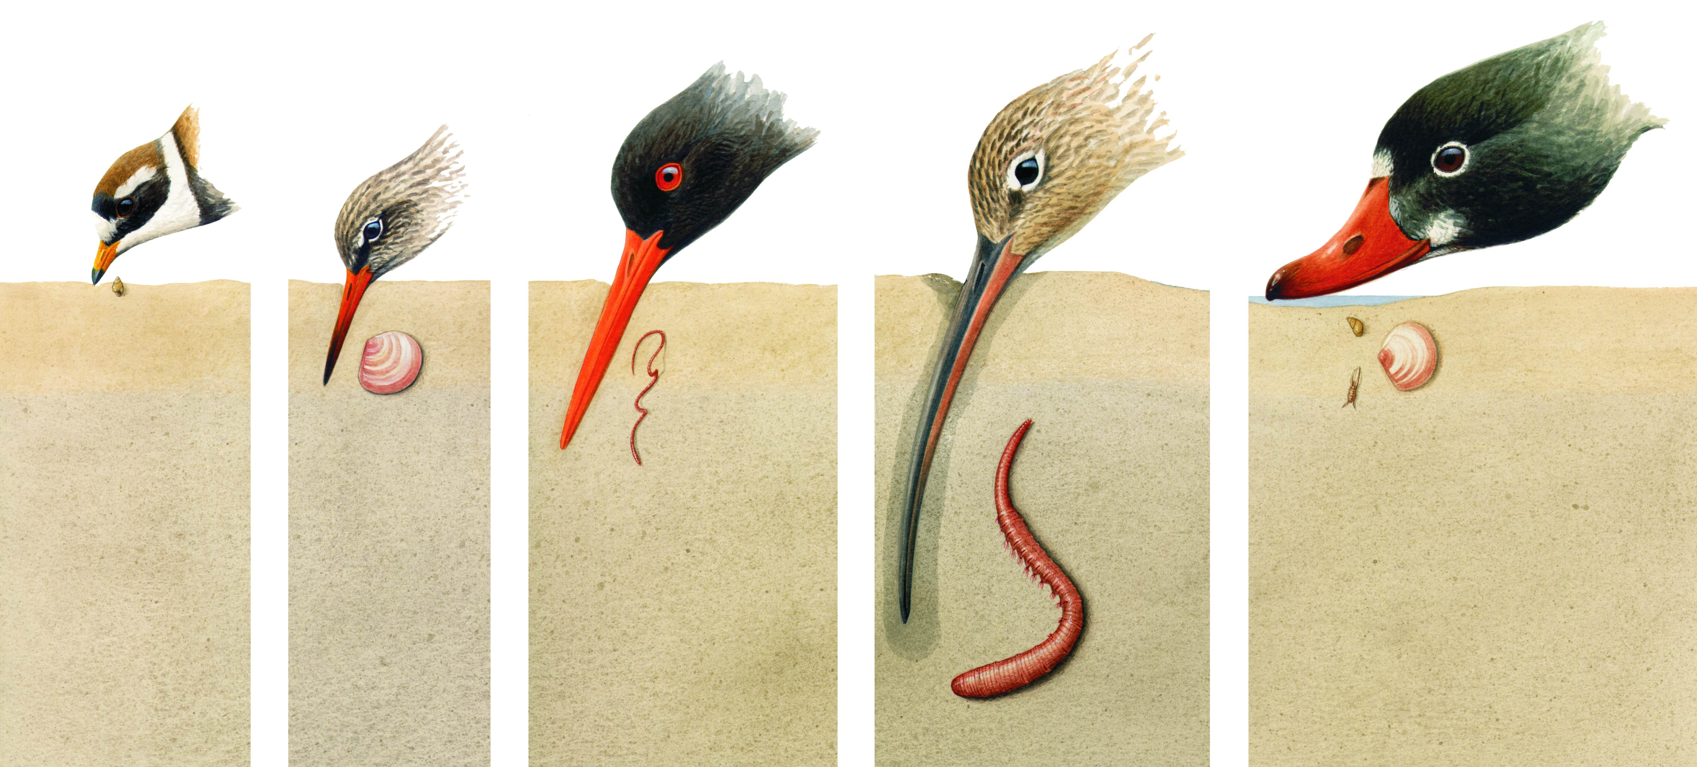
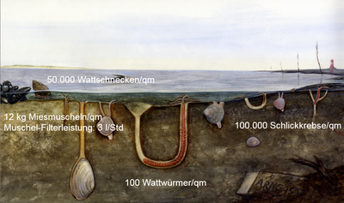
Criteria to assess global importance
Ecological processes,
natural forces and dynamics prevail
Undisturbed natural processes
Species richness
Productivity is one of the highest in the world
Key site for migratory birds

Slide 9
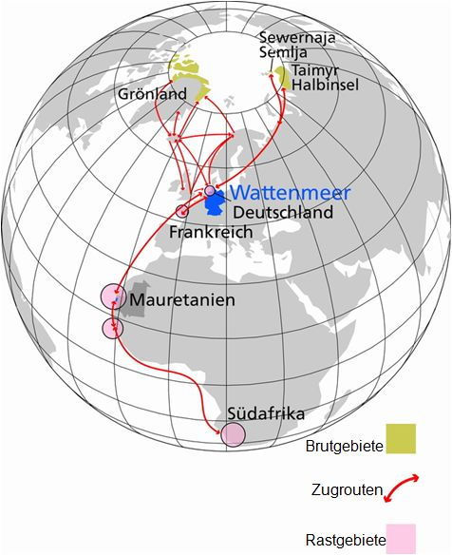
Criteria to assess global importance
Biodiversity: Unique in its variety
10,000 species
Cross roads for 12 million birds
Essential stopover enables the functioning of the East Atlantic and African-Eurasian migratory flyways

Slide 10
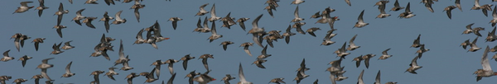
Furthermore…
The World Heritage is highly protected!
The World Heritage is big enough to contain all universal values of the extraordinary key factors.
The management of the World Heritage is secured on the long-run.
The status of protection of the World Heritage is sufficiently high.

Slide 11
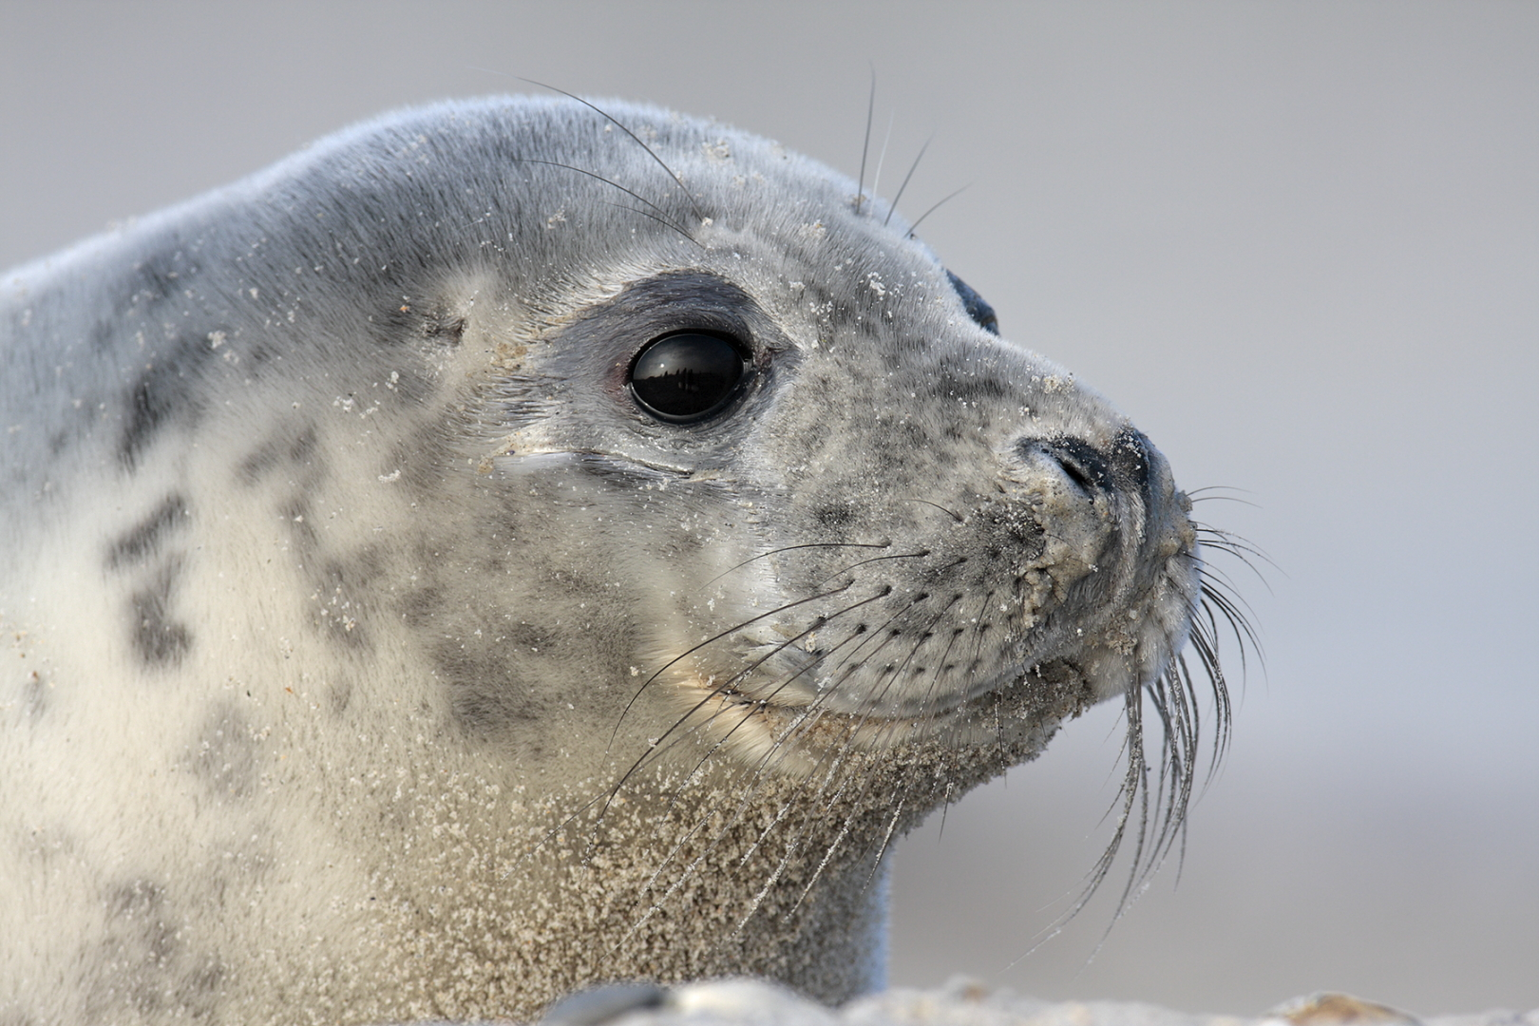
Weltnaturerbe Wattenmeer
- It‘s everyone’s concern!

Slide 12
World Heritage
and tourism

Slide 13
World heritage and tourism– a good match?

Slide 14
A perfect match!
Important touristic topics in World Heritage:
- Cycling - Hiking
-Water Experience - Experience of Nature
- Wellness, Health, Thalasso - Birdwatching
- Culinary Art - Sustainable Gastronomy
- School trip

Slide 15
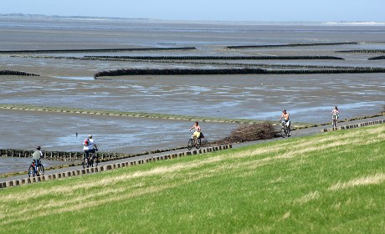
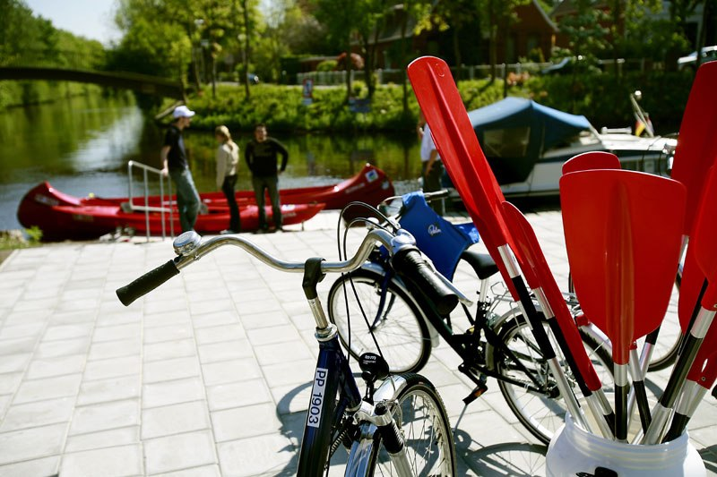
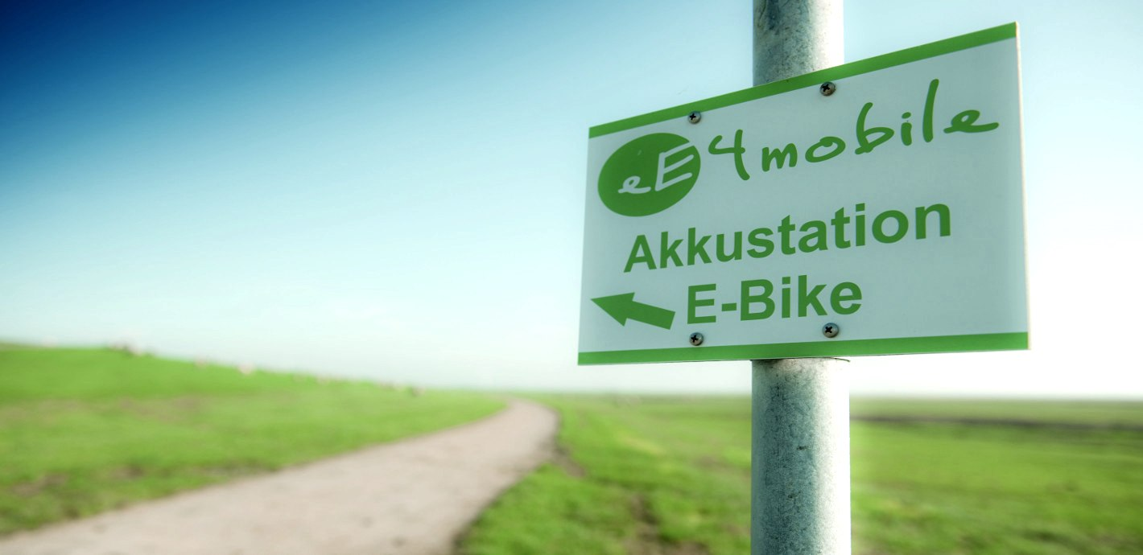
Cycling, Hiking, Water Experience

Slide 16
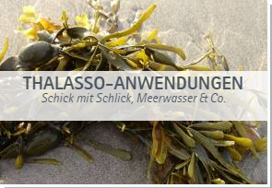
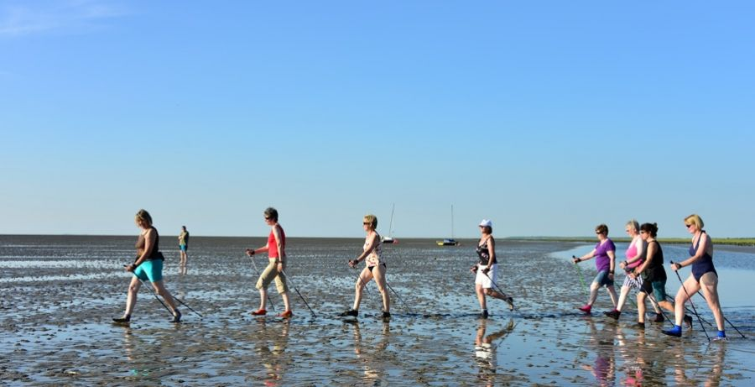
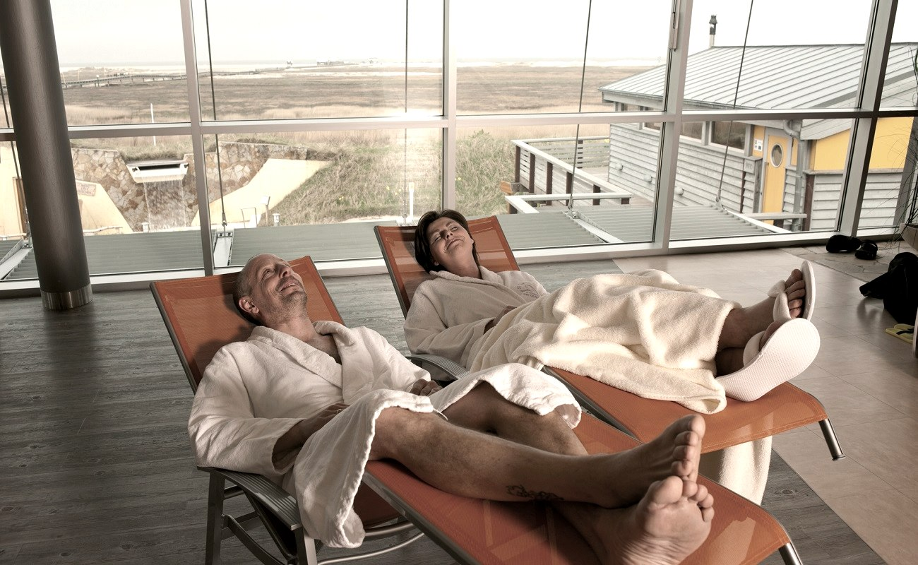
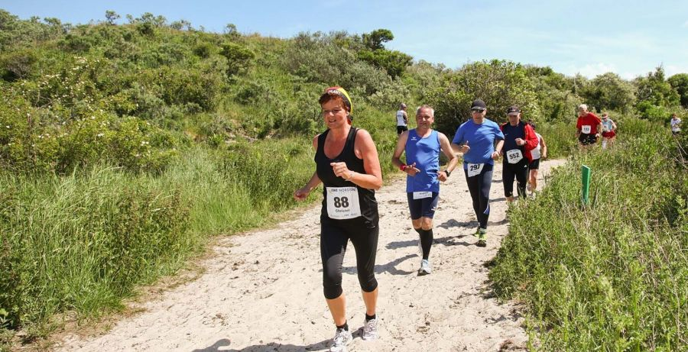
Health

Slide 17
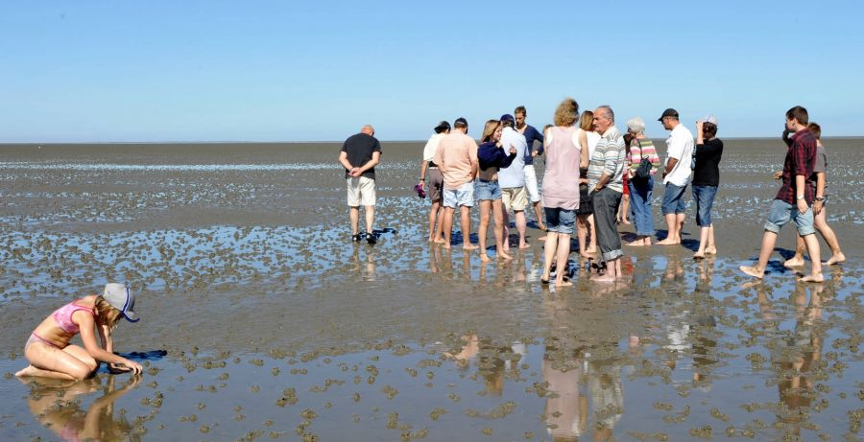
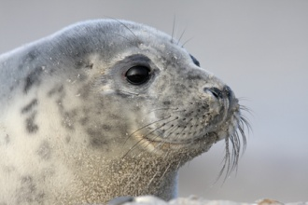
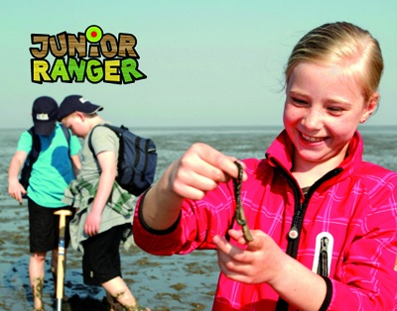
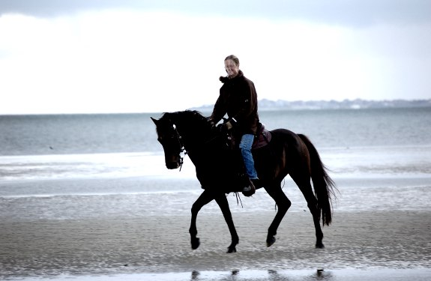
Experience of Nature

Slide 18
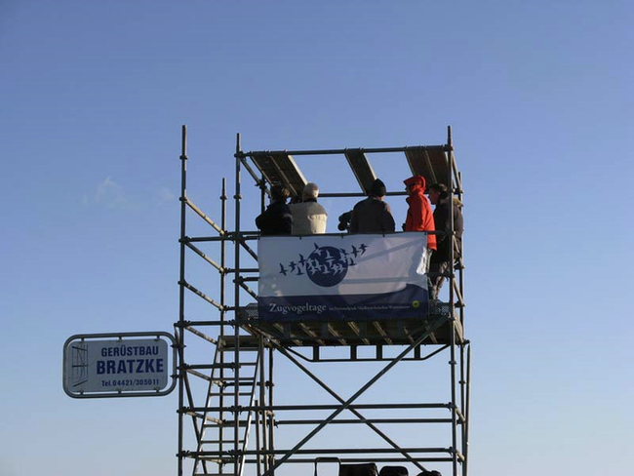

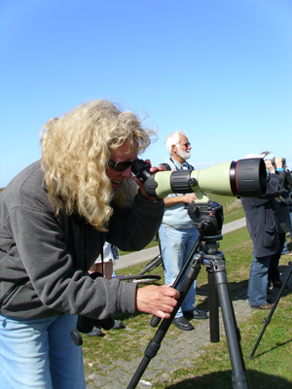
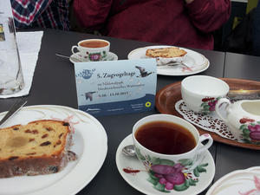
Birdwatching

Slide 19
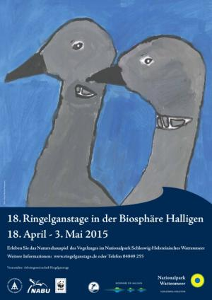
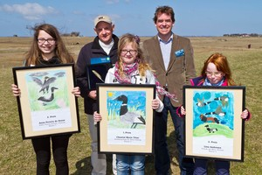
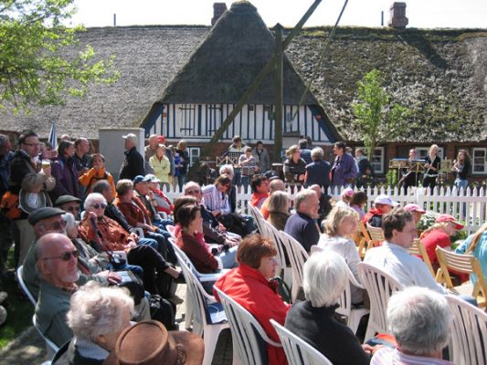
Birdwatching

Slide 20
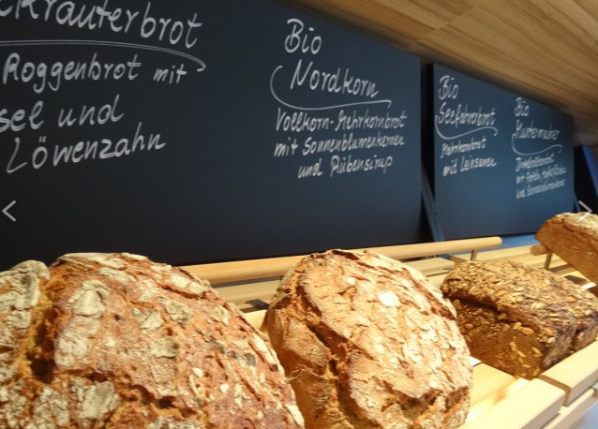

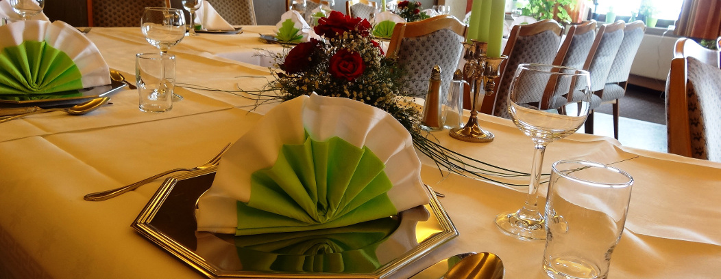

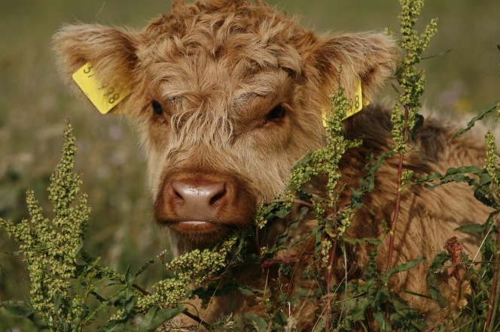
Sustainable Delight

Slide 21
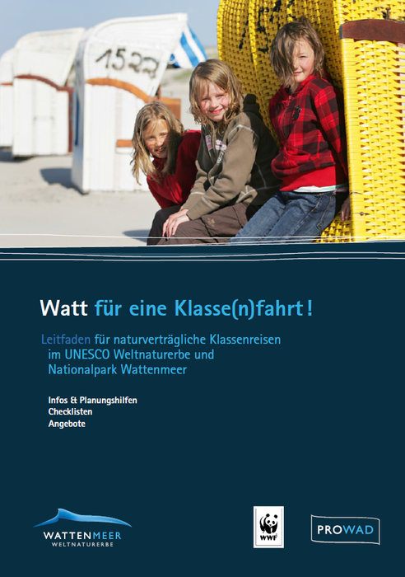
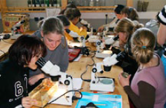
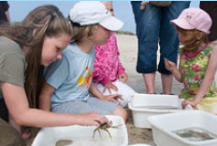
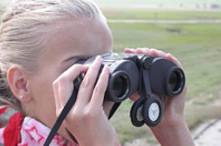
School Trip

Slide 22
Tourism strategy

Slide 23
Key statistics
10million
3-5 billion €
50 centres
tourists per year,
about 50 million overnight stays, 30 – 40 million day-trippers every year
estimated yearly
turnover of tourism in the Wadden Sea region.
in NL, D and DK supply information, guided tours, environmental education a.s.o.

Slide 24
The strategic objectives
1. All stakeholders have a transnational understanding and appreciation of the values of the Wadden Sea
2. Stakeholders have responsibility for and contribute to the protection of the ‘Outstanding Universal Value’
3. The tourism sector provides consistent communication and marketing
4. Nature conservation, tourism and local communities benefit from the World Heritage Status

Slide 25
Branding -
the ‘Wadden Sea
World Heritage’

Slide 26
One brand for the
‘World Heritage Wadden Sea’
We all benefit from a strong and distinctive Wadden Sea World Heritage brand.
FOR YOU: a brand for our World Heritage helps build our global reputation, enhance our collective visibility, and encourage greater collaboration and investment.
FOR VISITORS: a brand for our World Heritage communicates the quality and uniqueness of the Wadden Sea and its value to the world.

Slide 27
Benefits of one
World Heritage brand
We are all proud to be a part of this great natural heritage site. There are many benefits:
Raising awareness of the Wadden Sea as a single entity.
Building our global reputation
Enhancing our collective visibility
Encouraging greater collaboration and investment.

Slide 28
Why the brand is important
World-class
reputation
Awareness
Familiarity
Reaches out to and educates a wide audience
promotes a positive attitude and builds lasting relationships and loyalty
attracts sustainable tourism and promotes local business

Slide 29
Brand values
Branding is our opportunity to define who we are, as well as who we want to be in the future. Our brand values guide the quality and tone of all our communications:
Committed
Irreplaceable
Inspiring
To both present and future generations
In harbouring a wealth of biodiversity
As a unique natural environment

Slide 30
Our brand essence
This defines the Wadden Sea World Heritage, it’s the key message that defines the destination and why it is globally important.
One Wadden Sea,
One Global Heritage
A wealth of biodiversity.
A landscape of unique
natural dynamics.
An unforgettable
experience for all.

Slide 31

Supporting your local brand
Within the Wadden Sea region there are a lot of well-known destination brands.
We want to invite these brands to share the values of the ‘Wadden Sea World Heritage’ brand.
We hope you will embrace the Wadden Sea World Heritage brand to help communicate our global significance.

Slide 32
Your brand tools
PROWAD have developed a number of tools to help you play your part in strengthening the Wadden Sea brand including:
New World Heritage website
Marketing & Communication toolkit
Brand guidelines
Photography suite
Key messages
Set of fast facts
Promotional products and marketing materials

Slide 33
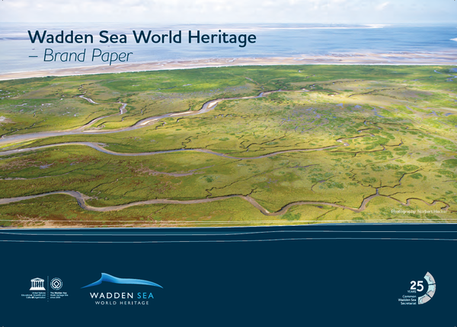
The Brand Paper

Slide 34
Instruments for tourism in the ‘Wadden Sea World Heritage’

Slide 35
Promotional material

Slide 36
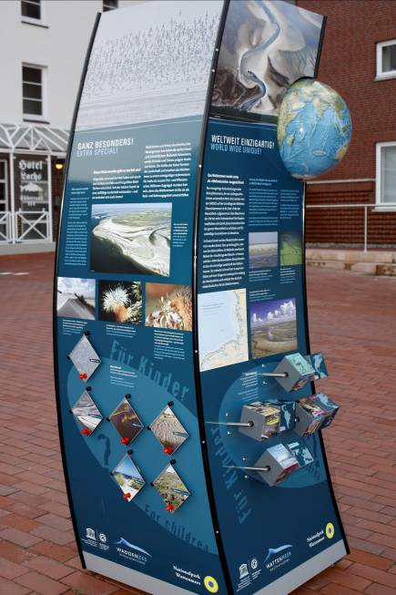
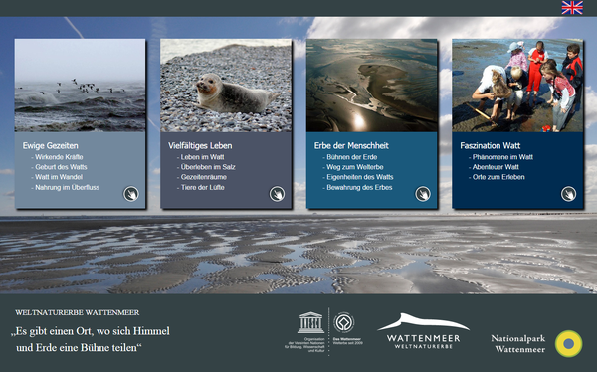
Info module

Slide 37
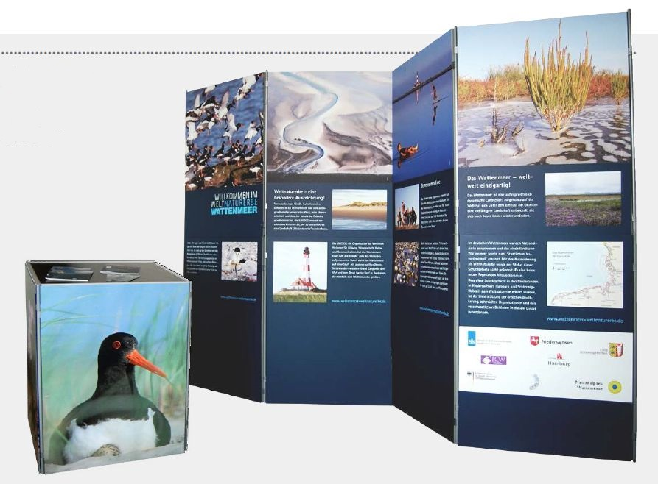
World Heritage Exhibition

Slide 38
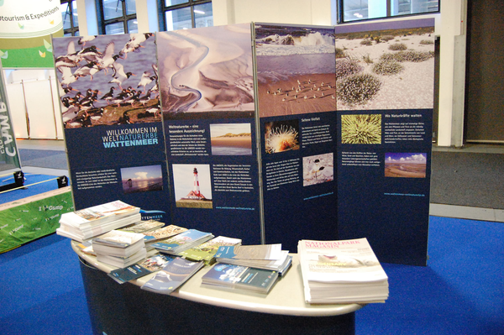
World Heritage Exhibition

Slide 39
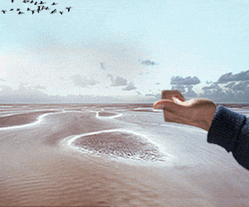


Online banner

Slide 40
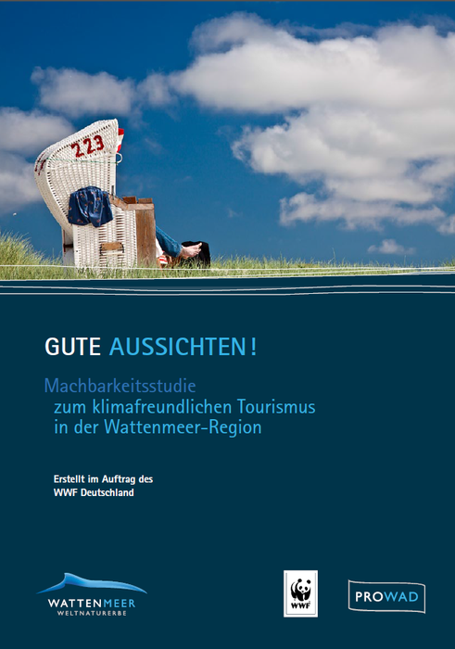

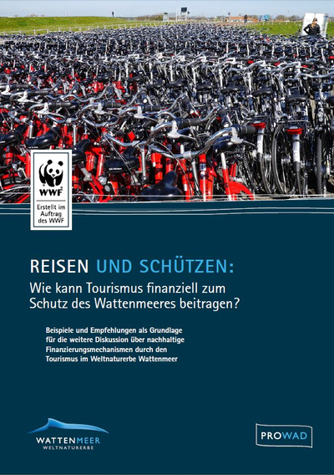
Studies and Guidelines

Slide 41
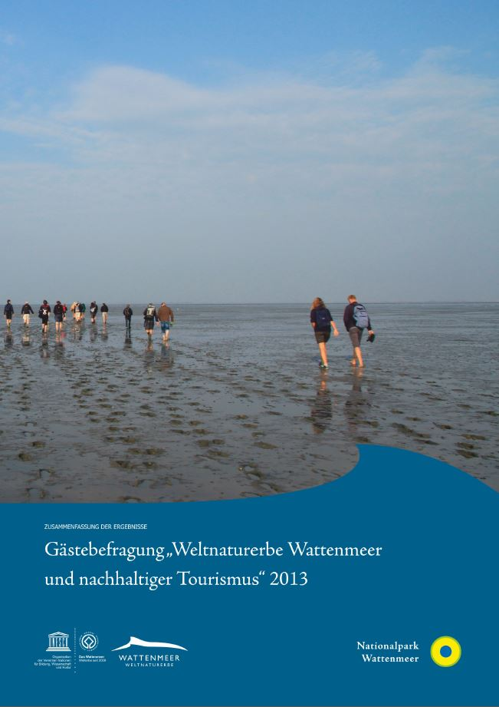
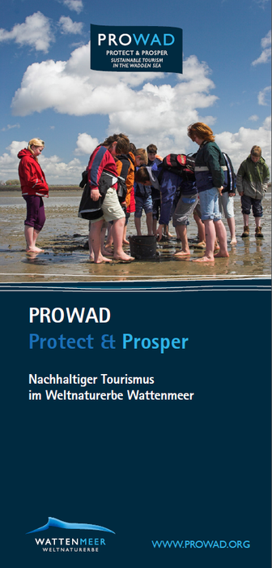
Studies and Guidelines

Slide 42
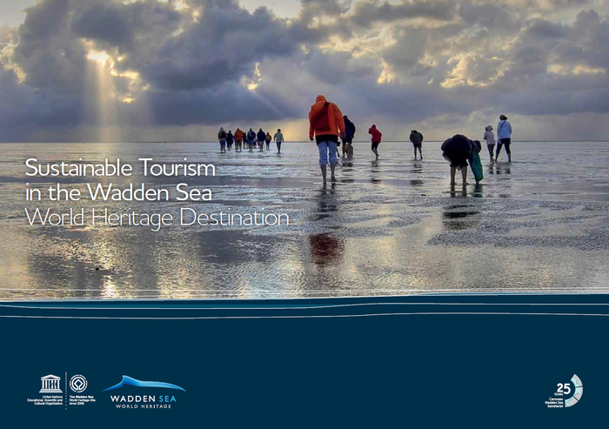
Flyers and Brochures

Slide 43
Photo library

Slide 44
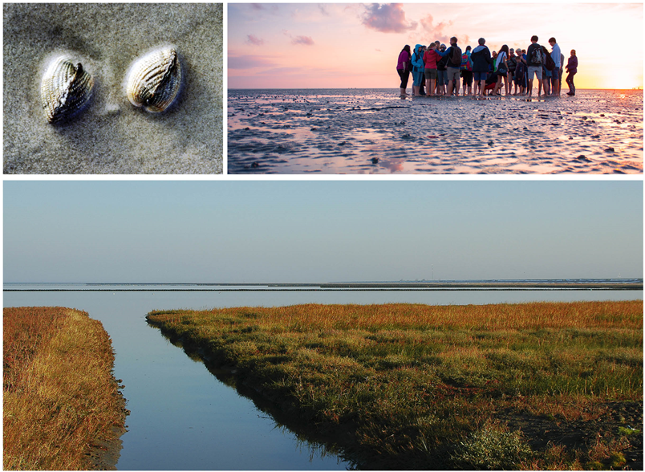
Photo library

Slide 45
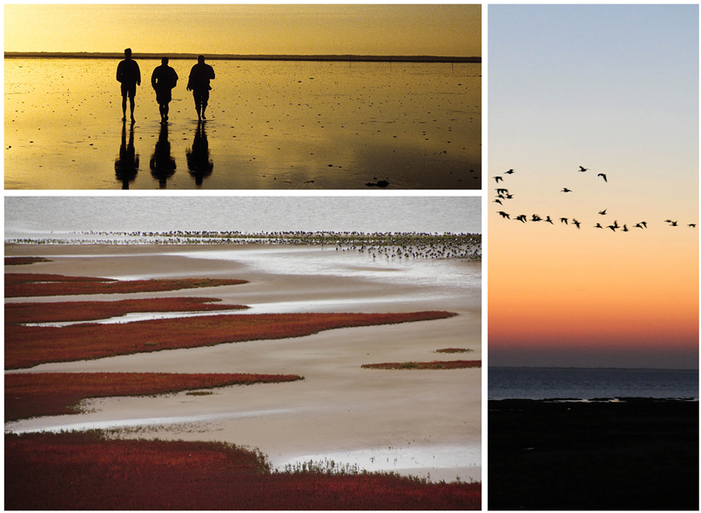
Photo library

Slide 46

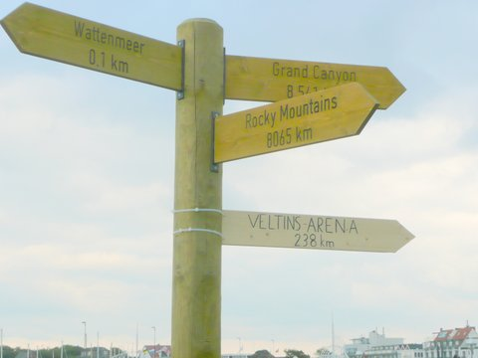
Signposts
5 indicator plates along the German motorways
Signposts to World Heritage Sites around the world

Slide 47
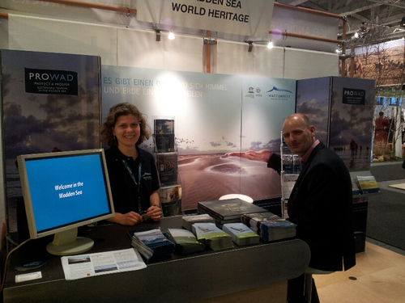
Exhibitions and Fairs
Performance on many exhibitions:
ITB Berlin
Roadshows
Regular guests‘ fairs

Slide 48
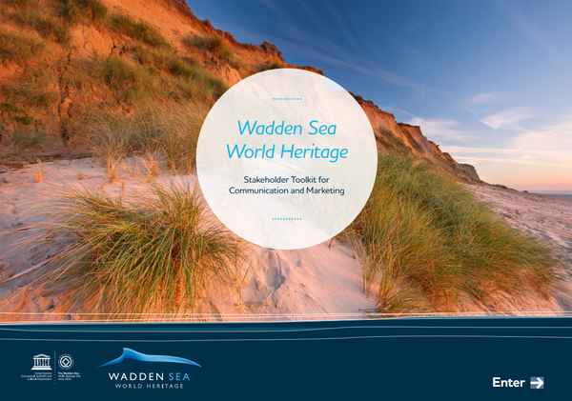
In a nutshell: The Toolkit

Slide 49
Is it possible to strengthen lokal economy through World Heritage?

Slide 50
Benefits to the economy
Gaining and keeping qualified employees
Additional value through sustainable business focus
Strengthen local identity
Strengthen inter- and intrasectoral networks
Creation of synergetic effects by the use of regional and international cooperation

Slide 51
Securing qualified employees

Slide 52
Work where others spend their vacation
Employees do not only want to work!
Where and how can I lodge?
What and how much do I receive for my money?
How do I spend my leisure time?
How far is it to go to work, cinema, theater or the city center?
Is there an appealing living environment?
Does the quality of live fit?

Slide 53
Work where others spend their vacation
The employee is (in the majority of cases) not alone!
The employee (in the majority of cases) does not decide alone!
Partner
children
Parents
You have to convince the “Decider”!

Slide 54
Work where others spend their vacation
Families needs and wished have to be completed!
Is there an appropriate care provision for the children?
What about the range of schools and apprenticeships?
What about nursing care for the parents?
Are there sufficient leisure activities for every family member?
Do the children raise in a healthy/safe environment?
Is the quality of live guaranteed?

Slide 55
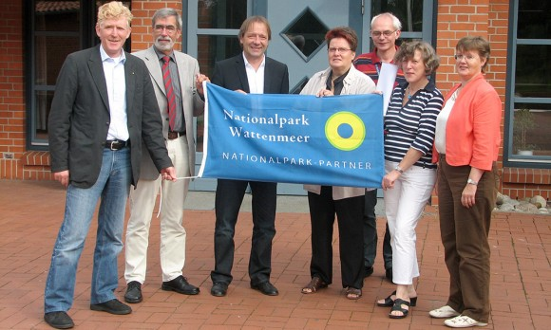



National Park-Partner

Slide 56
World Heritage and nature conservation–
It belongs together!

Slide 57
Education for Sustainable Development

Slide 58
What means Sustainable Development ?
Ecology
Economy
Social
A fair world
A viable world
Sustainable
Development
A world
Worth
living on
See: zen-ensdorf.de

Slide 59
Education for Sustainable Development
ESD teaches kids, teenagers and adults to think and act in a sustainable manner.
They put people in the position to make decisions for the future.
Thereby they learn to estimate, how their own acting influences future generations or the live in other world regions.
Experience of nature is the key!

Slide 60
Education for Sustainable Development
Impart knowledge:
About global coherences and challenges like climate change or global equality.
About the complex economic, ecologic and social causes for these problems.

Slide 61
Education for Sustainable Development
Impart competence:
Proactive thinking
Interdisciplinary knowledge
Autonomous acting
Participation in social decision-making process

Slide 62
Education for Sustainable Development
Through education for sustainable development the individual learns:
My acting has consequences.
Not only for me and my environment, but for other people „somewhere else“.
I can do something to make this world a better place.

Slide 63



Best Practice
Training course for National Park- Partner and Wadden Sea National Park guides and tourist guides
Quality initiative for National Park guides
High amount of World Heritage- lectures, among others for locals, tourism information, trade associations, other associations, schools
E.g. „Rhetoric for captains“

Slide 64







Successful education-program for local kids, visitors and kids on vacation

Slide 65

Include locals
5 years UNESCO-Wadden Sea World Heritage– free mudflat hiking tour for locals
26. till 28. June 2015
On all islands and 11 places on the mainland

Slide 66



Nature conservation and regional development
Rubbish collection campaign
Fishing for litter
Joint activities of tourists and National Park Administration for nature conservation

Slide 67
Active for the World Heritage
My contribution!

Slide 68
Tourism strategy
Online unter: www.waddensea-worldheritage.org

Slide 69
Tourism strategy

Slide 70
Tourism strategy

Slide 71

Guideline for tourism industry
Inform
promote
Get involved
See: http://www.prowad.org/news/2015-06-30-guidelines-world-heritage-package-tours

Slide 72

Guideline for tourism industry
Market analysis
Situation analysis
Recommendation of Birdwatching offers in the Wadden Sea World Heritage
See: http://www.prowad.org/news/2015-07-06-study-touristic-bird-watching-offers

Slide 73





Guideline for advertising allowance
Development of a guideline through a bachelor thesis and the project PROWAD
Cooperation partner: Die Nordsee GmbH, National Park, island Langeoog, Jade HS
Nationalpark Niedersächsisches Wattenmeer as „Case-Study“
The guideline will be provided for the other Wadden Sea countries

Slide 74
That is what you can do
Use the official World Heritage information material addressing to guests
Regular exchange with your National Park house, joint offers and activities, reciprocal linking etc.
Steady information of Landlord and service providers about World Heritage and new offers

Slide 75
That is what you can do
Use online-poster and digital banner of Common Wadden Sea Secretariat (CWSS)
Complement your E-Mail signature with the suppliment „with best regards from the National Park and UNESCO- Wadden Sea World Heritage “

Slide 76
Thank you very much
for your attention
www.waddensea-worldheritage.org

Slide 77
Appendix

Slide 78
Tourism strategy in detail

Slide 79
Sustainable tourism…
1. Is aware of the natural values of the Wadden Sea and accepts the global responsibility for its protection as a result of the World Heritage status.
2. Contributes to the protection, conservation and presentation of the Wadden Sea World Heritage property.
3. Promotes the cooperation with tourism stakeholders in a participatory approach to maximise conservation, and presents outcomes whilst minimising the threats and adverse impacts from tourism.

Slide 80
Sustainable tourism…
4. Presents the Wadden Sea World Heritage property in an adequate, consistent and comprehensive way, which mobilises awareness, understanding and support for its protection.
5. Meets community and economic benefits for present and future generations while at the same time sustaining the conservation objectives.

Slide 81
Sustainable tourism…
6. Offers high quality, low impact tourism (products, services, facilities), which considers the ecological requirement of the property.
7. Contributes to regional development.

Slide 82
1. Strategic objective
To ensure all stakeholders have a transnational understanding and appreciation of the values of the Wadden Sea World Heritage.

Slide 83
2. Strategic objective
To ensure stakeholders take responsibility for and contribute to the protection of the ‘Outstanding Universal Value’ through involvement in tourism management and product development.

Slide 84
3. Strategic objective
To ensure the tourism sector provides consistent communication and marketing and promotes the high quality tourism offers of
the Wadden Sea World Heritage Destination.

Slide 85
4. Strategic objective
To ensure nature conservation, tourism and local communities benefit from the World Heritage Status.

Slide 86
Example: Tourism planning in Denmark
Esbjerg Municipality’s “Planning for Tourism 2014-18”:
Coherent tourist political considerations are a prerequisite for localisation of new holiday and leisure facilities in the coastal zone
New holiday and leisure facilities and major expansions of existing facilities to be located in existing urban or major holiday and leisure areas
New marinas must not be placed in the open coastal landscape
No planning of new holiday home areas in the coastal zone, and existing holiday

Slide 87
Co-operations and partnerships

Slide 88
Networks
Networks in the World Heritage Site
AG Weltnaturerbe Wattenmeer Niedersachsen (D)
Weltnaturerbe-AG Westküste und Trägergruppe Fahrtziel Natur, Schleswig-Holstein (D)
Stuurgroep Waddenzee Werelderfgoed (NL)
Styretøj og kontaktgruppe Vadehavet (DK)

Slide 89

Co-operation
meinFernbus + Zugvogeltage: information package with „die nordsee“-Magazin, meinFernbus-timetable and the birdwatching-days-flyer: ca. 3000 packages
meinFernbus + meinMeer + Zugvogeltage + Nordsee GmbH: lottery and extra pages

Slide 90
Co-operation
Nordsee* + Deutsche Bahn (German Railway): Fahrtziel Natur
Cooperation of Deutschen Bahn with BUND, NABU, VCD for environmental friendly tourism in major conservation areas
2012-2014: World Heritage marketing campaign with TASH und TMN
Information about environmental friendly arriving with train and local mobility
Integration of bookable offers

Slide 91



Co-operation

Slide 92

Co-operation
Passenger information offer of the Nord-Ostsee-Bahn (NP-Partner) through National Park-guide Dörte Hansen
See: www.youtube.com/watch?v=3BI0niyjY04

Slide 93


Ferry boats & Shipping
Providing the island-ferries with information-boards for the World Heritage and National Park
Configuration of a World Heritage lounge on board of the MS Ostfriesland, AG Ems
Rhetoric for captains

Slide 94


National Park-Partner
Slaughterhouse Claußen in Tönning
NP-/World Heritage-Logo on paper bags
Every bag is accompanied by a Multimar-Flyer

Slide 95

Nationalpark-Partner
Fairtrade-Chocolate “Watt´n Glück”
from Büsum
Per sold chocolate 1 € for the World Heritage
Donations are used to finance Strandmüllboxen (beach garbage boxes) in Büsum
See: www.nordsee-onlineshop.de/watt-n-gluck-schokolade-mit-fairtrade-siegel-70-g.html

Slide 96

Waddengoud
Wadden Gold is a label for local products and services from the Dutch Wadden Sea Region.
The brand is managed by the Foundation Wadden Group, a non-profit foundation,
includes 300 individual products (mainly agricultural and mostly organic produced) and
about 75 services (tourist, gastronomic, art and culture).
See: www.waddengoud.nl

Slide 97
Offer for visitors of the Wadden Sea World Heritage

Slide 98


Nature adventure offer
Great variety of qualified nature adventure offers
At a certified national park mudflat hiking tour or a nature excursion
At a certified national park adventure tour

Slide 99


Ranger: important contact person
2014: Strong political signal for a significant expansion of the ranger-system

Slide 100
Zugvogeltage at the National Park Niedersächsisches Wattenmeer
Series of events at 9 days in October
Over 250 offers, 12.500 visitors
Aims:
Awareness-raising for global importance of the Wadden Sea for migratory birds (Recognition criteria for World Heritage!)
Offer with high focus on quality and sustainability
Cooperation of National Park- Information center, National Park Partner und service provider

Slide 101









Zugvogeltage at the National Park Niedersächsisches Wattenmeer

Slide 102

Urlauberbus
The ‘Urlauberbus’ in Lower Saxony offers environmentally friendly mobility opportunities to explore the National Park and the hinterland.
For 2 Euro per ride, people can use every bus in the Ems-Jade area.
Won the national ‘Fahrtziel Natur’ award.
See: www.urlauberbus.info

Slide 103

Online-Shop in the Netherlands
See: winkel.waddenvereniging.nl

