Slide 1
Re-use of vacant / under-utilised industrial buildings Dr Simon Parris Department of Town and Regional Planning, University of Sheffield
Notes:
Say thank you for doing it in English and sorry. The only (largely) empty building I am going to discuss, I’m not going to say a great deal about!

Slide 2
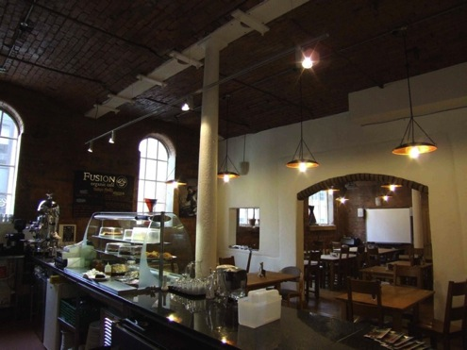
Three possible options for community
re-use of the Boiler Building
Open Market Disposal (with restrictions)
Community Buyout
Community Asset Transfer

Slide 3
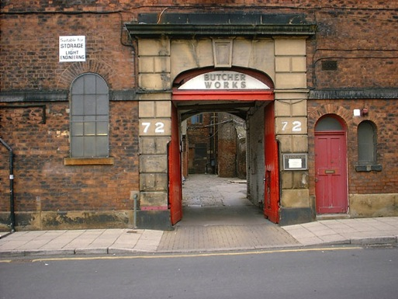
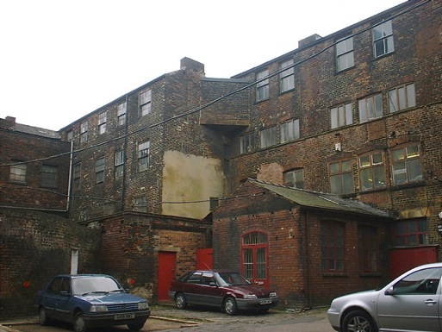
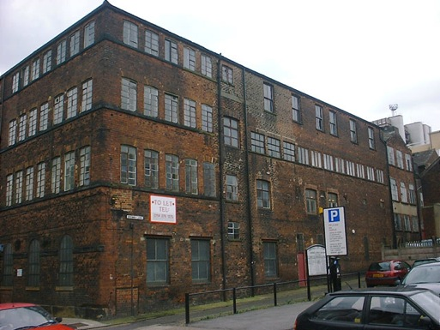
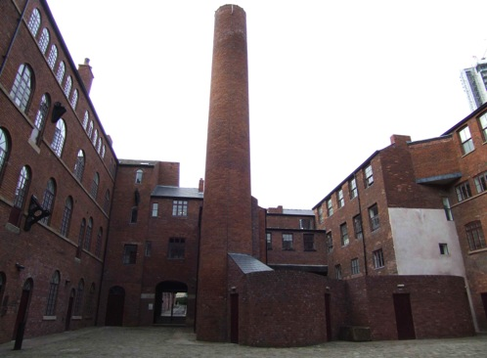
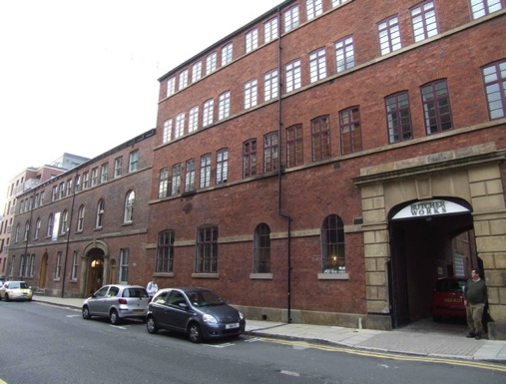
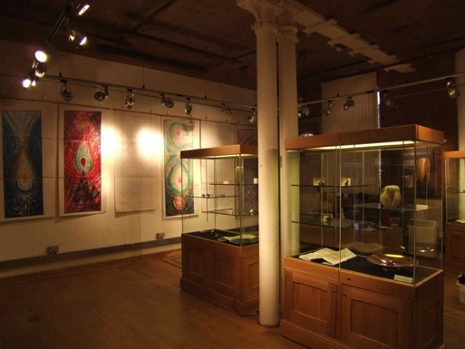
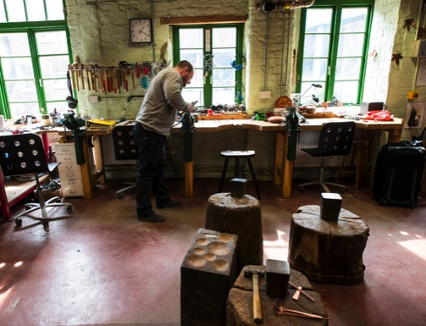
Butcher Works,
Sheffield, UK
(Open Market)
Notes:
Local authority can place restrictions on what re-development can take place.
Costly refurbishment of key heritage asset in city, offset by local authority offering developer adjacent site, specifically for move-on business space. Local authority withheld lease agreement for adjacent site until Butcher Works’ refurbishment was substantially complete. Thus getting what it wanted. But in the event, move-on space failed to sell and adjacent building was sold to one of the city’s universities.

Slide 4
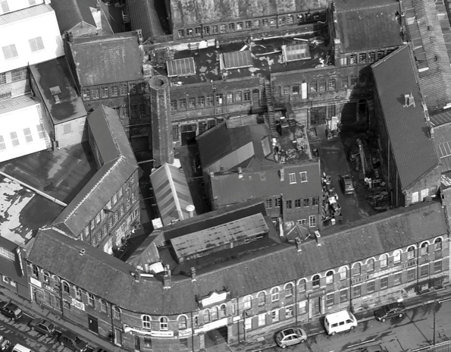
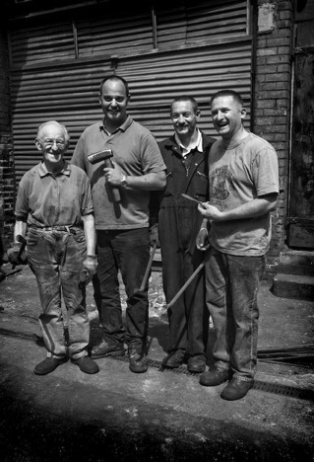
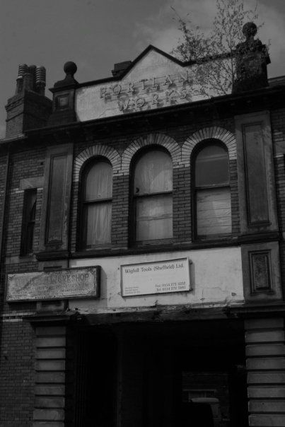
Portland Works,
Sheffield, UK
(Community Buyout)
Purpose built cutlery work constructed in 1870s (Grade II*). First place to manufacture stainless steel cutlery
35 people, 20 diverse businesses / studios; metalworkers, engineers, craftspeople, artists and musicians (one tenant using machinery installed when works built)
2008/2009: Private owners apply for ‘change of use’ and advertise for sale (residential, 70 small apartments)

Slide 5
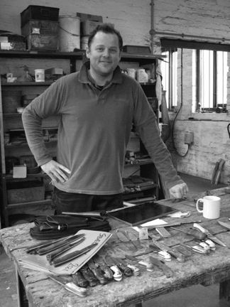
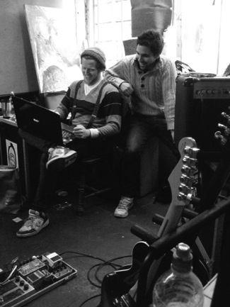
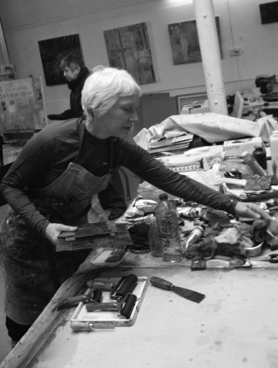
January 2009: First public meeting initiated by a tenant, an architect and a councillor:
“… drew a large number of people, from the Works, the local neighbourhood and from other similar works buildings each representing what Portland meant to them and their city... and what they felt might be lost. For some this was their livelihood, specialist skills, their heritage... and for others, it was communities, relationships or a cheap space in the city to be creative.”
First aim: oppose the planning application and save building as a place of work
Initially activist: ‘Save Portland Works’
No legal grounds for opposition, but destruction of ‘living heritage’
If planning refused, owner would raise rents. So what next?
January 2010: Second public meeting decided to try and buy the Works! But how?

Slide 6
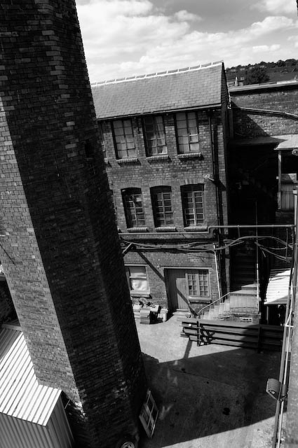
Campaigning against planning application: long, grinding process of gaining attention via
Facebook / blog / website / marketing materials / open days / student and community projects / local and national newspaper, radio and TV coverage / celebrities
June 2010: £10k KT grant from University of Sheffield; how own and manage? (case studies)
Agreed to establish ‘Industrial Provident Society for Benefit of the the Community’
Owned by members, but benefits also go to wider community. Will purchase via community share issue (each holder, one vote)
September 2010: John Street Triangle Audit submitted to planners (student project)
Notes:
Unlike a company limited by guarantee, an IPS generally has a share capital. However, in a not-for-profit IPS the share capital may be limited to a nominal amount. Both types of IPS have a share capital, but it is usually not made up of equity shares like those in a company limited by shares, which appreciate or fall in value with the success of the enterprise that issues them. Rather they are par value shares, which can only be redeemed (if at all) at face value. The profits and losses of an IPS are thus the common property of the members. The share typically acts as a "membership ticket", and voting is on a "one member one vote" basis. The maximum individual withdrawable shareholding is currently set at £20,000 (although other IPSs may hold more shares than this). The Legislative Reform Order (Industrial & Provident Societies and Credit Unions) Order 2011 removed the limit for non-withdrawable shares. See LRO info from FSA. Since 2006, the FSA has been willing, in principle, to permit societies to have non-user investor members providing certain conditions are met and this, in combination with the removal of the £20,000 holding limit for non-withdrawable shares, may open up wider possibilities for co-operatives to raise finance from investors while maintaining user control. It may be withdrawable share capital, an unusual form of finance which is treated as equity but may be withdrawn subject to specified conditions, and is relatively cheap for small co-operatives to raise as it is exempt from certain regulations applicable to conventional share issues regarding the publication of a prospectus. However, an IPS with withdrawable share capital is not allowed to carry on a banking business, presumably because a withdrawable share capital would make it impractical to ensure capital adequacy requirements are continuously met.

Slide 7
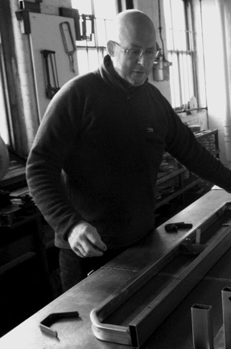
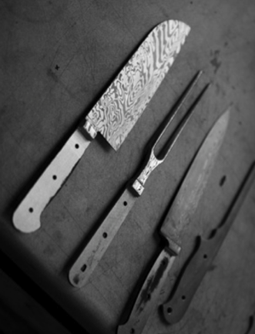
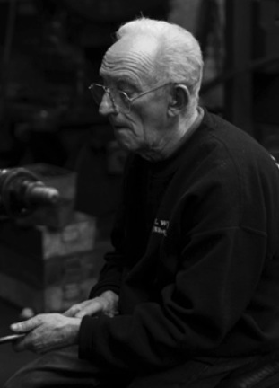
January 2011: Pro bono costing
March 2011: Online petition, 1,500 signatures
Council indicate informally that may refuse owners’ application and showed support for buyout (huge number of objections, including MPs)
Pro bono negotiation support from well known local businesspeople; owners get reality check
May 2011: Business plan completed (with pro bono support from Cooperative Enterprise Hub)
May 2011: Owners withdraw planning application
June 2011: Share issue launched, £450,000 target
June 2011: John Street Triangle designated conservation area to prohibit housing redevelopment

Slide 8
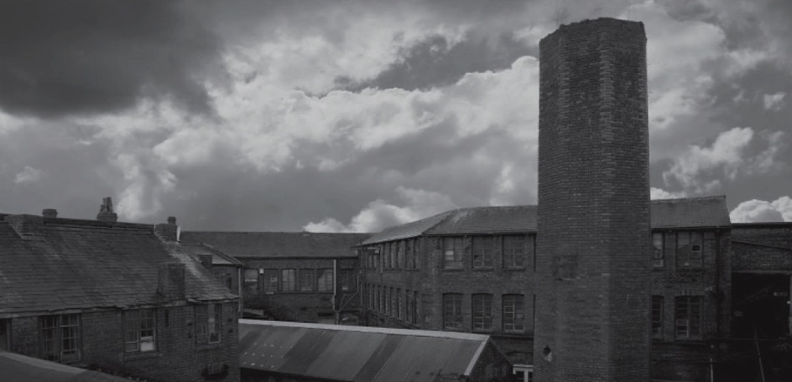
Total Raised: £624,450
Community: £367,000 (59%)
Liabilities: £303,000 (49%)
2011 Sheffield City Council – £250 for start-up costs
2011 South Yorkshire Community Fund – £5000 for open days
2011 Sheffield City Council / Community Assembly – £7000 for survey costs
2011 and 2012 Sheffield Town Trust – £6700 for purchase process and campaigning
2011 and 2012 South Yorkshire Key Fund – £25,000 grant for CBS / share purchase
2012 J G Graves Trust – £1500 for renovating stone portico
2012 Freshgate Trust Foundation – £1000 for purchase process
2012 Architectural Heritage Fund CSG – £10,000 for initial development costs
2013 Architectural Heritage Fund Loan – £200,000 acquisition loan (bridges gap)
Individual Donors – £5000
Community Share Issue – £260,000 (500+ shareholders, £100-£20,000, Jun 2011–Nov 2013)
Community Bonds – £103,000 (3 and 5 year)
Notes:
£100-£20,000 – could be £1, but too costly to administer, £20,000 was max legally allowed. Now unlimited to enable investors to invest, but co-operatives to maintain control.
Freshgate Trust Foundation: founded by Harry Brearley
J G Graves Trust – John was a watchmaker (mail order)

Slide 9
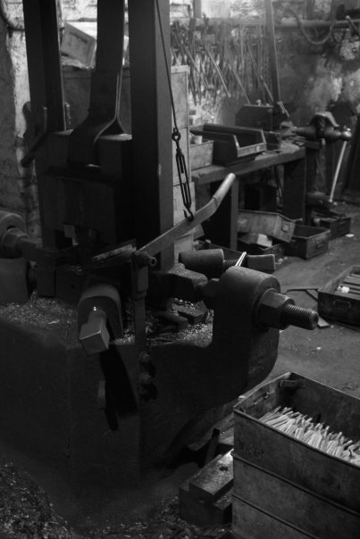
March 2012: Owners agree in principle to £420,000 purchase price
March 2013: PWLS receives keys to Works, delayed due to contractual agreement
The deal involves a staged purchase, £260,000 up front and £160 over 4-years
“...one of the biggest community buy-outs in the country should guarantee that the building where stainless steel cutlery was invented can continue to house craftspeople, who plan to teach their inherited skills to young people in Sheffield.” (The Guardian, 24/02/2013)

Slide 10
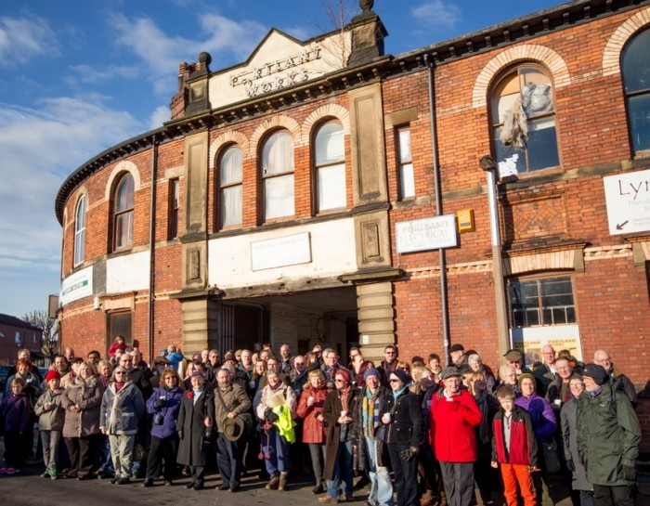
Portland Works Little Sheffield Ltd. Vision
"...is that Portland Works will be a physically sound, fully-occupied building owned and managed in a democratic way by its tenants and supporters. It will provide affordable workshops and studios for craftspeople and the creative industries and for small business start-ups.
The management will be responsive to their needs, fostering opportunities for education and promotion of the heritage values of the Works, along with support for workplace training and apprenticeships. We envisage Portland Works playing an important role as the centre of a hub of similar developments in the neighbourhood of Little Sheffield and beyond."
Portland Works:
January 2009
– March 2013
http://www.portlandworks.co.uk
Notes:
Nov 2013: We've now completed about half our urgent Health and Safety work - notably stabilising the entrance and portico area, repairing fire alarm systems, fire escapes, upgrading the power supplies and providing some working toilets! Now our priority is mending the roof, initially doing temporary repairs but ultimately a full-scale renewal. This will enable the building to dry out. Now we're owners, we can apply for renovation grants, but these take a while to come on stream, so we expect our first two years will be difficult, with conflicting priorities and many calls upon our resources. We have a good group of skilled and experienced volunteers to guide us though, and in our planning we have taken a long view with a clear sense of purpose.

Slide 11
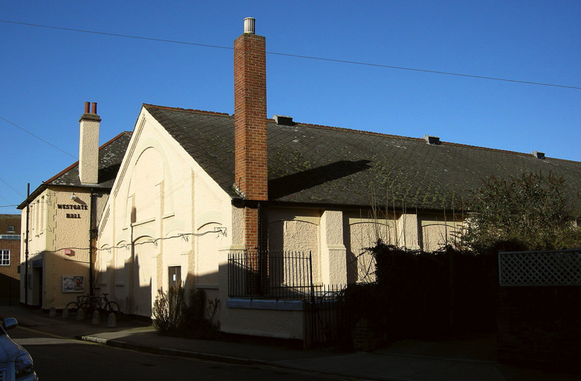
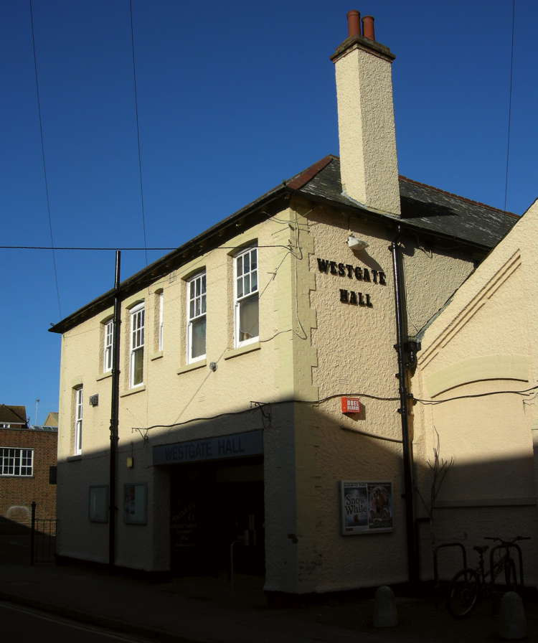
Westgate Hall,
Canterbury, UK
(Community Asset Transfer)
Military drill hall, built in 1913
More recently used as conference, dance, fair, voting, blood donation, emergency, music, and community venue (400 seated and 650 standing)
February 2010 – Council votes to demolish due to budget cuts and high maintenance / refurbishment costs despite, 30,000 visitors p/a
Notes:
In central Canterbury, just off main High Street.
Council would have replaced with surface level parking…

Slide 12
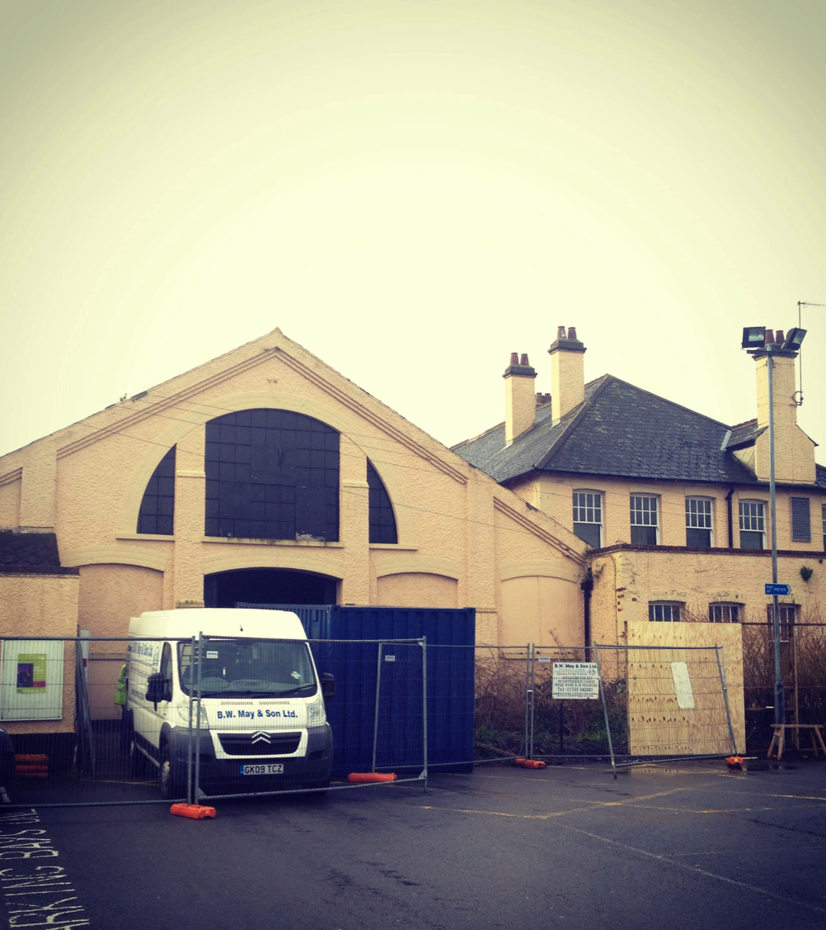
“Westgate Community Trust aims to preserve, refurbish and manage the Westgate Hall to serve the needs and interests of the present and future residents of Canterbury and its districts. In the process it aims to strengthen community spirit. It is nonpolitical. All are welcome.”
March 2010 – Westgate Community Trust constituted in response to Council by members of 1,300 strong ‘Save Westgate Hall’ Facebook page
April 2010 – Trust presents business plan proposing alternative model based on social enterprise to Council
Council agrees to continue funding hall until July 2011 and requests second business plan. If proven financially self-sustaining, lease will be granted to Trust
Notes:
Initially 6 Facebook members constituted Trust, with 14 at formal constitution, with additional absentees. Some lived in Canterbury all their lives. Some had only lived their a few months. Journalists, musicians artists, historians, financial planners, actors, lawyers, community workers, restaurant owners, local residents, out-of-town people, self employed, and civil servants.

Slide 13
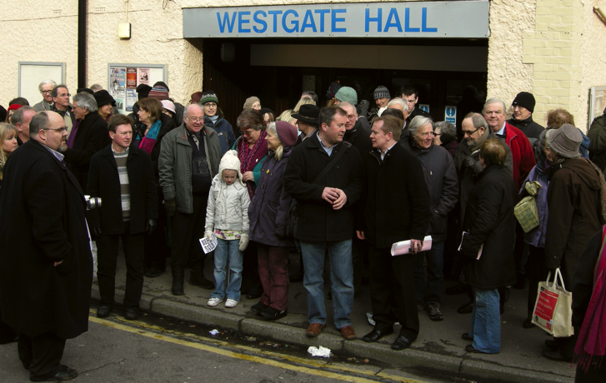
Website (1,952 followers)
Visited a voluntary / community sector ‘funding fair’ to make contact with potential funders
Qualified for Development Trusts Association membership
Won £6000 Natwest Community Force Award for takeover / business plan costs (printing, publicity, legal fees, insurance, initial running costs, etc.)
Chicken and egg situation: can’t get funding without formal tenure, can’t get formal tenure without funding
Trust consults community (residents, public, private and voluntary sectors) using questionnaire (700+ responses for business case)
Programme of events (some Council funding) held at the hall for local residents and businesses to raise both takeover funds and the Trust’s profile
Landscaping and planting of donated plants (local nursery and Council, who also supplied a gardener)
Notes:
Development Trusts Association membership, qualifications: (1) Engaged in economic, social and environmental regeneration of a defined area or community (in our case, Canterbury); (2) Independent and aiming for self-sufficiency/not for private profit; (3) Community based, owned and managed; (4) Actively involved in partnerships between the community, voluntary, private and public sectors
The Trust aims to raise £10,000 by September 2010 to cover “take over” costs and those incurred while producing the business plan (printing, publicity, legal fees, insurance, initial running costs etc.). Our fundraising capacity will confirm community commitment. We have already raised an incredible £3000. Huge thanks to all of you who have contributed.

Slide 14
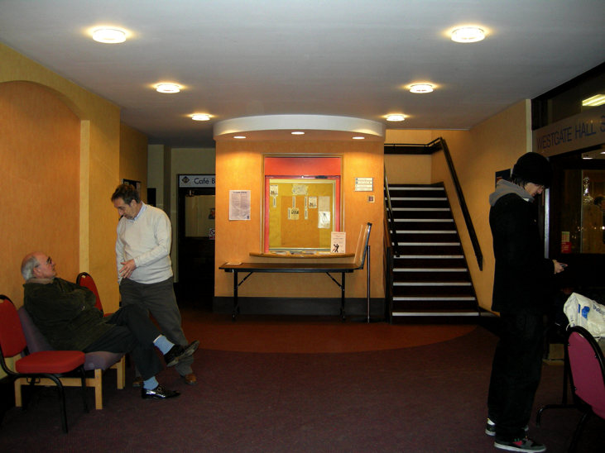
Secured financial support of Curzon Cinemas (£1.7m committed; CEO, former University of Kent student)
Trust to run ‘village hall’ and sub-lease two-story building to Curzon
Curzon pays lump sum toward Hall’s refurbishment (secure future - roof)
Curzon to develop 3-screen digital ‘arthouse’ cinema and bar
Cinema will:
attract people to a leisure an community resource
create jobs
compliment Council’s ‘cultural regeneration’ of the city centre
Trust changes from community organisation to company limited by guarantee with charitable status
July 2011 – Council convinced by second business case for community centre and cinema, and votes to award 99-year lease (in principle…)
January 2013 – Planning permission granted (refurbishment)
Notes:
Cultural regeneration precedents: Marlowe Theatre and Beaney Museum (2010 Best Business Award for Best Local Authority)

Slide 15
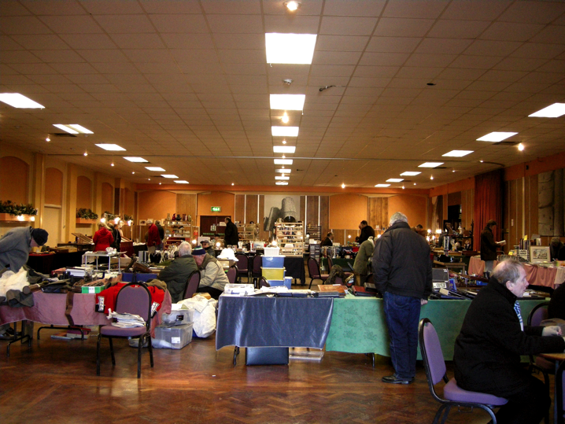
All in ‘new territory’ (scheme, recession, Big Society, Localism, Community Right to Bid )
Three legal teams, three different cities
Transfer of public asset to company limited by guarantee with charitable status, with a private company as tenant
7 documents, cumulatively 300+ pages
January 2014 – Trust signs 99-year lease and begins refurbishment (2y6m or 3y11m later)
February 2014 – £344,497 grant from DCLG Community Asset Fund (£5.5m, 17 schemes)
Autumn / Summer 2014 – Curzon cinema due to open
April 2013 – “So, why haven't we signed?”
Problem = lease negotiations (time)
Three parties:
Westgate Community Trust (voluntary / non-profit)
Curzon Cinemas (private)
Canterbury City Council (public)
Notes:
DCLG grant proves chicken and egg thesis.

Slide 16
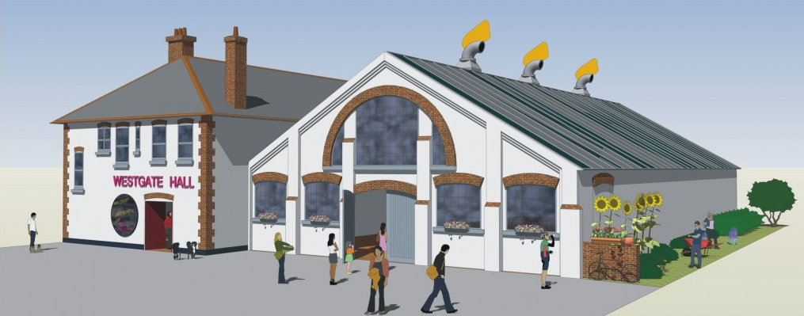
Westgate Hall: February 2010 – January 2014
“… proposed plan presents a unique collaboration between the voluntary, public and private sectors, and as such, a model for localities nationwide. It’s the product of a huge team effort and of three “C’s”: Council, Corporate, Community. The lynchpin: community.”
“… the one-two-three tempo has defined how matters have evolved — between the characters, the characters with their legal teams, the legal teams with each other. Every now and again, someone has stepped on someone’s dress or toes… but that’s part of what dance lessons are about.”
http://westgatehall.org
Notes:
???? Three c’s, etc. sub-text
Formalisation… fitting Las language, buy community lynchpin
“What is particularly exciting about the Westgate Hall adventure is that it confirms what can be achieved when a community recognizes what is important to it, rallies to protect it, and engages in creating solutions. In this case, the Trust, a small band of enthusiasts with a dynamic membership, grew and was supported by Canterbury’s communities in saving the hall.”

Slide 17
The Three C’s
Community
Absolutely at the heart of both projects (activist campaigns)
In both cases the community maintains control of the buildings
Council
Portland Works: Heritage, creative industries, ‘makers’, manufacturing, stainless steel, community work, affordable workspace, save / create jobs, research (i.e., John Street Triangle)
Westgate Hall: attract people to a leisure an community resource, create jobs, compliment Council’s ‘cultural regeneration’ of the city centre
Corporate
Portland Works: Viable business with potential to expand
Wesgate Hall: Use part of space to provide commercial income and investment for community space
Notes:
In both the Case of Portland Works and Westgate Hall, the community organisations were able to maintain full control of their respective properties.

Slide 18
Useful Links
Architectural Heritage Fund http://www.ahfund.org.uk
Cooperative Enterprise Hub http://www.co-operative.coop/enterprise-hub
Community Shares http://communityshares.org.uk
Cooperatives UK http://www.uk.coop
My Community Rights http://mycommunityrights.org.uk
Portland Works (research) http://www.portlandworks.co.uk/research
Westgate Hall (news) http://westgatehall.org/category/news

