Slide 1
Valuation & evaluation: How can the valuation and evaluation of open space contribute to its long-term management? Experiences from MP4 pilot projects
Green Growth: New Shoots
10th May 2012
Pieter Vercammen
VLM

Slide 2
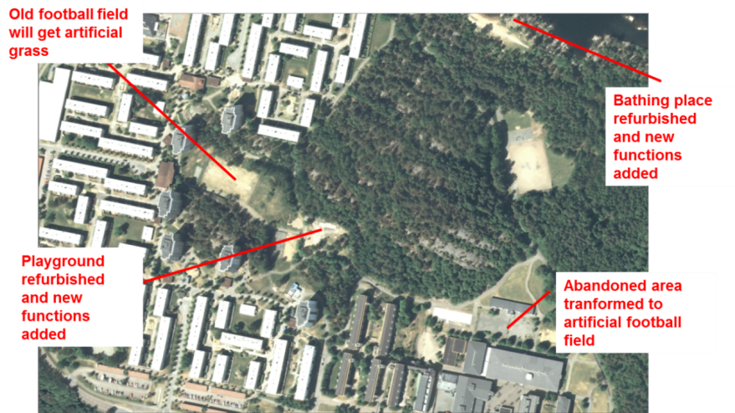
On the ground: establishing a baseline through Sociotope mapping - Gothenburg, Sweden
MP4 pilot example: Lövgärdet and Eriksbo
two housing estates from the 1960s and 1970s with under-used adjacent nature areas (lake and green spaces).
Mostly occupied by a deprived community.
Objective: renew the physical environment in a sustainable manner, encouraging socio-economic growth and long-term improvements to increase the attractiveness of open space.

Slide 3
On the ground: establishing a baseline through Sociotope mapping - Gothenburg, Sweden
Gothenburg Sociotope mapping
background information which was used in the overall analysis of the park’s situation within the city.
Mapping user preferences, qualities and weaknesses in the green structure.
How?
User surveys, discussion panels, site observations, interviews with residents and people working in the area
Questions: frequency of visits, indicate importance of sites, purpose of visit…
Integration of all that information into one sociotope map

Slide 4
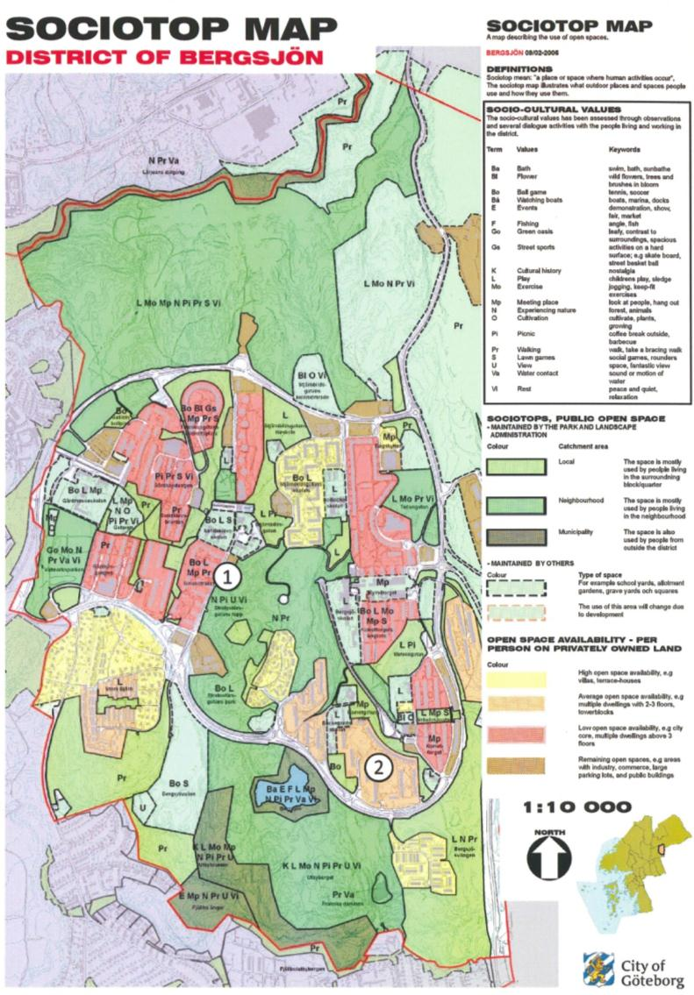
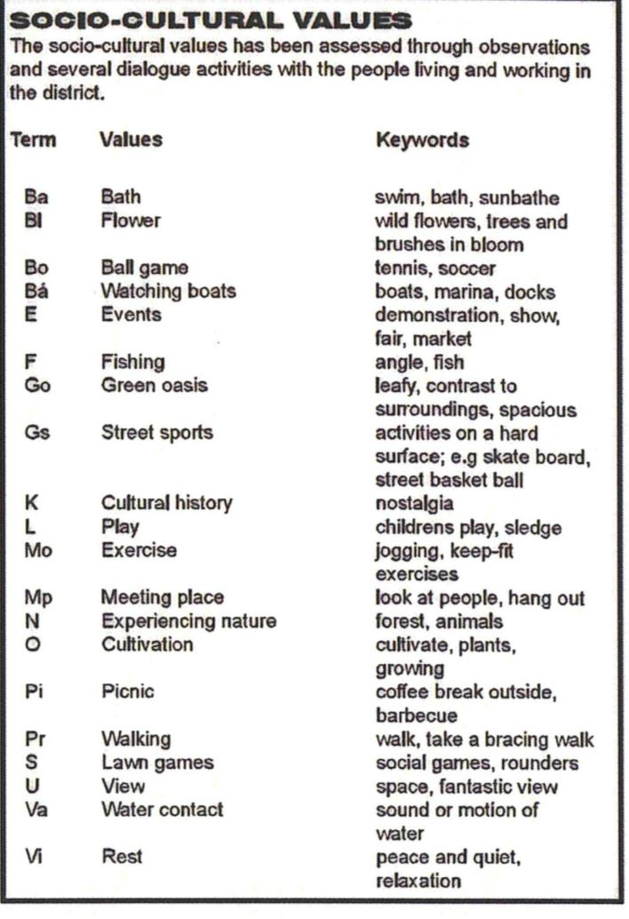
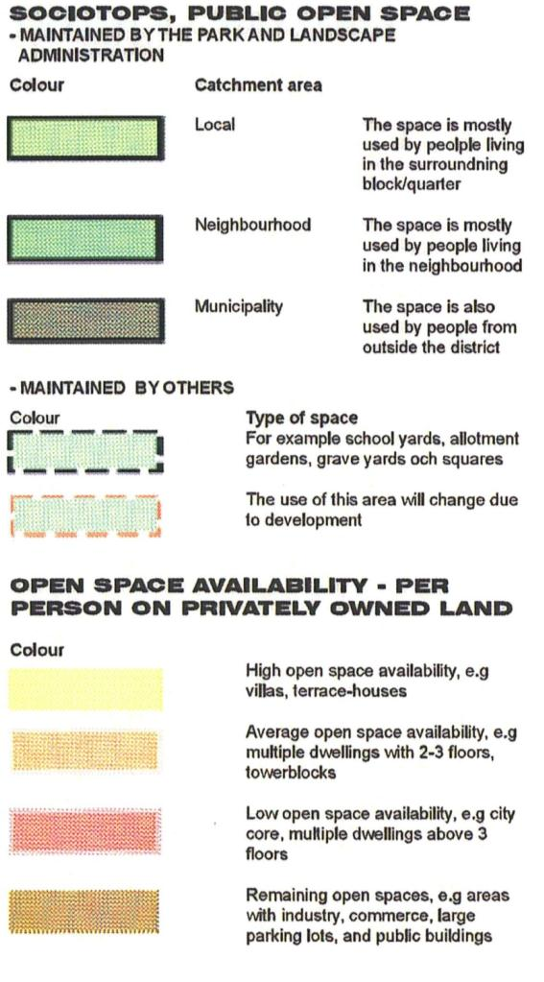
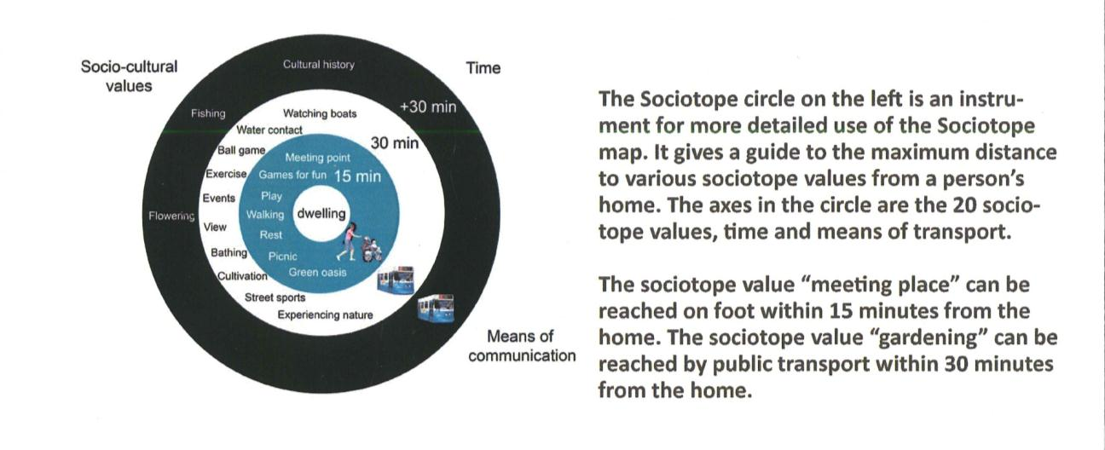

Slide 5
On the ground: establishing a baseline through E-mapping - Gothenburg, Sweden & Sheffield, UK
E-mapping builds on the sociotope methodology
Building a layer with
Recreational experiences (memorable personal sensation)
Recreational zones
Recreational potentials
How
Interviews with user groups, surveys
What can it be used for
Site analysis
Identification of improvement potentials
Valuation of recreational value and quality

Slide 6
On the ground: establishing a baseline through Rec-mapping - Gothenburg, Sweden & Sheffield, UK
Mapping recreational experience in eight dimensions
EXPERIENCES IN RECREATIONAL GREEN-SPACES
NAME | SHORT DEFINITION / INTERPRETATION | IMPORTANT CHARACTERISTICS/ACTIVITIES
NATURE | Sensation of the free growing, untouched, vital, an encounter with nature on its own conditions. | No visible man-made facilities or traces, no visible or audible urbanity. ‘Nature areas’.
RICHNESS IN SPECIES | Sensation of richness in plants, insects and/or animals. | Presence of different or special plants, flowers, insects and/or animals. Possibility to gather mushrooms, fruits etc.
SERENE | Sensation of an undisturbed peacefulness, to be on one’s own, in safety and withdrawn in one with nature/surroundings. | No artificial noise (e.g. transport), few or no other humans, no garbage, no paths/transport corridors.
SPACE | Sensation of an independent, inter-connected and special ’universe’. | No cross-cutting paths or disturbing features. At least two types: A ‘hall of old beech trees’ or ‘an open horizon’ at a lake/the sea.
REFUGE | Sensation of safe and provided surroundings and facilities for expression, play and interactions with other people. | Demarcated and uncluttered space/place by trees, bushes, fences. Play facilities, tables/benches, meet animals. ‘Play ground’
PROSPECT | Sensation of open and free surroundings for expression and activity. | Open and accessible space with grass/sports fields / gravel fields. Supporting facilities such as light, changing rooms. ’The common’
SOCIAL | Sensation of organized and entertaining scene and get together with other people. | Provided and arranged facilities, services, activities, café, restaurants, benches, tables, barbeque and entertainment. ’A social scene’.
CULTURAL | Sensation of cultivated, man-made surroundings formed by history and culture. | Historical features and buildings, Sculptures, statues, fountains, canals, flower stands, well-cut bushes, formal elements. ‘Historical city park’.
Mapping of strength: 0: not present, 1: weak experience, 2: good experience, 3: a full experience

Slide 7
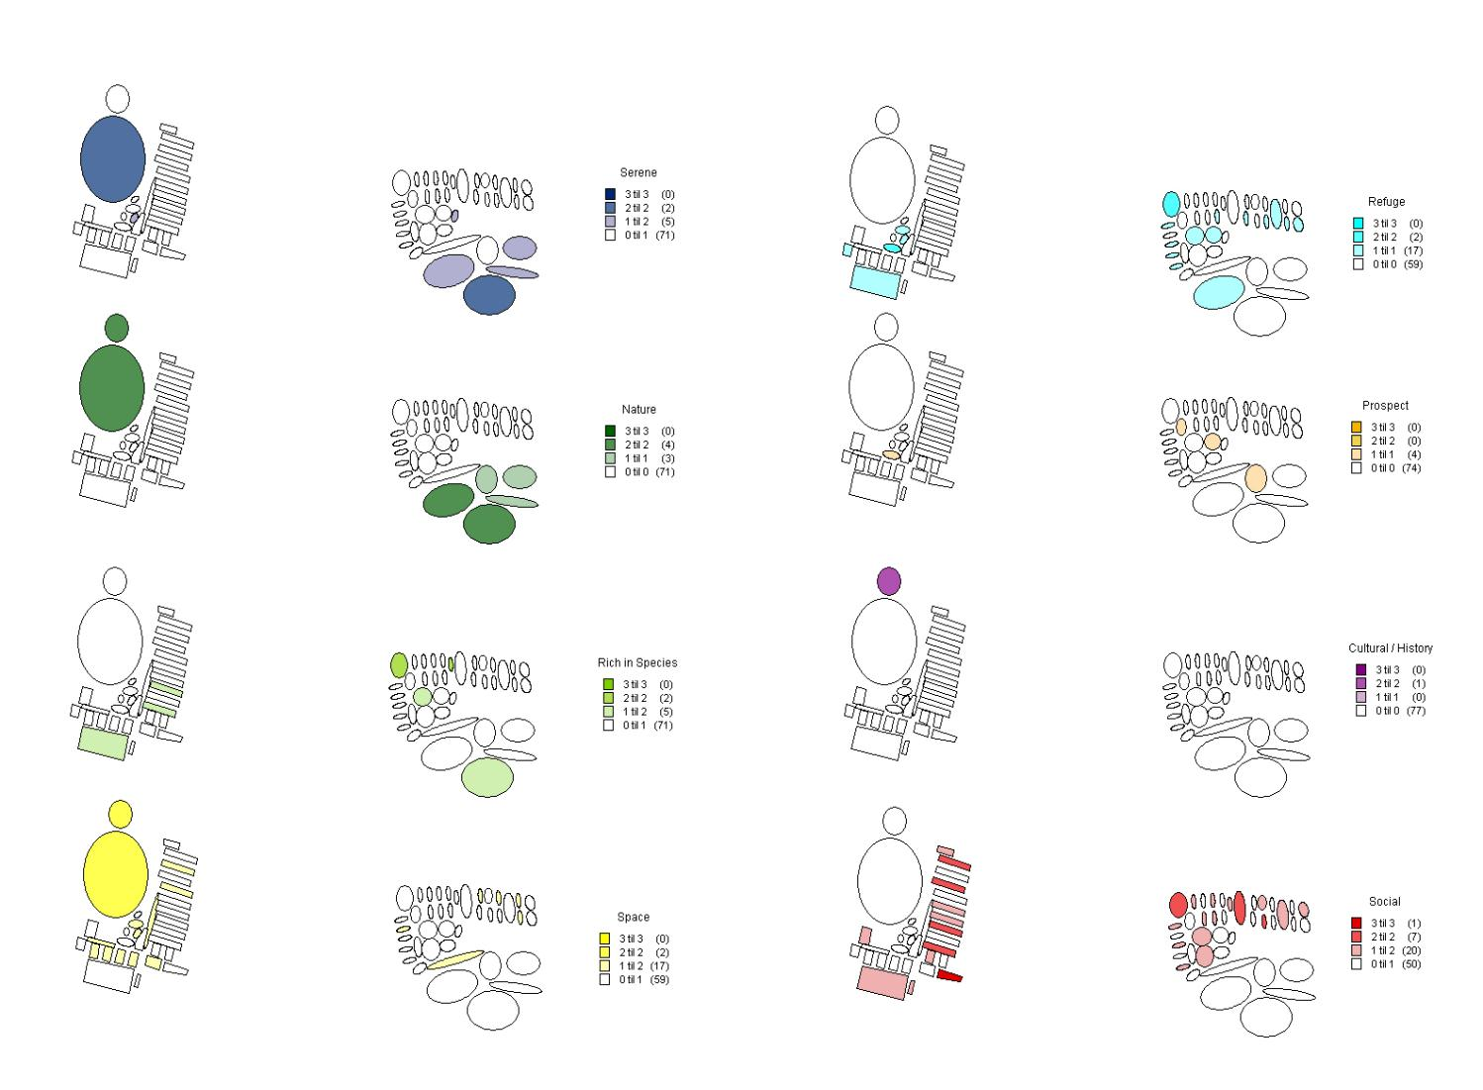
On the ground: establishing a baseline through Rec-mapping - Gothenburg, Sweden

Slide 8
On the ground: establishing a baseline through Sociotope and E-mapping
Use before investment:
Choose most profitable places for investments
Present ideas about how to direct the development of these places
Use after investment:
Tool to monitor the actual use and functionality
Place keeping efforts can be adjusted to actual use

Slide 9
On the ground: maintenance standards – Emmen, Netherlands
Setting the maintenance standards: use of visual rulers
Example: municipality Emmen
Emmen is responsible for maintenance of public (green) spaces
Five levels of maintenance A+, A, B, C, D
Maintenance on demand / image driven
Level of maintenance is
Agreed in discussion with inhabitants and municipality using a visual ruler
Dependent on available funding within municipality
Dependent on site type (sports park, residential area, commercial centre…)

Slide 10
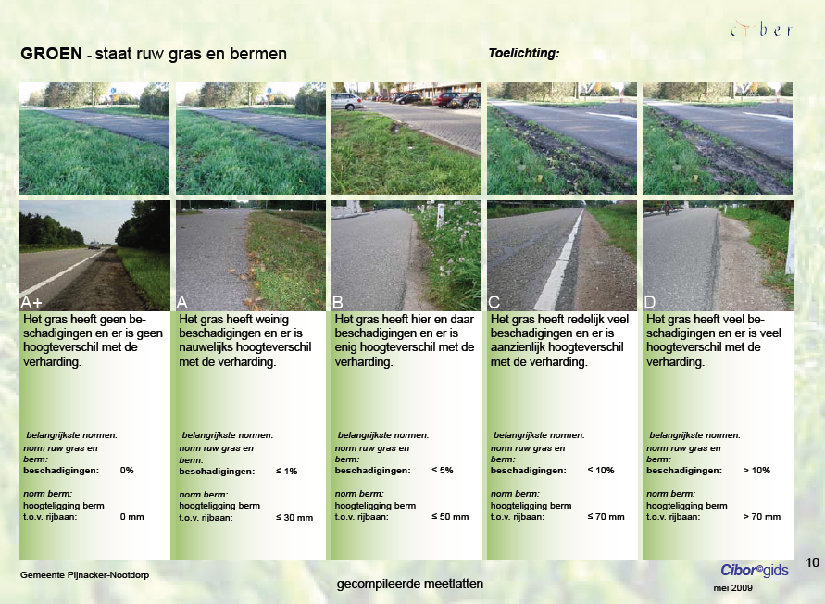

Slide 11
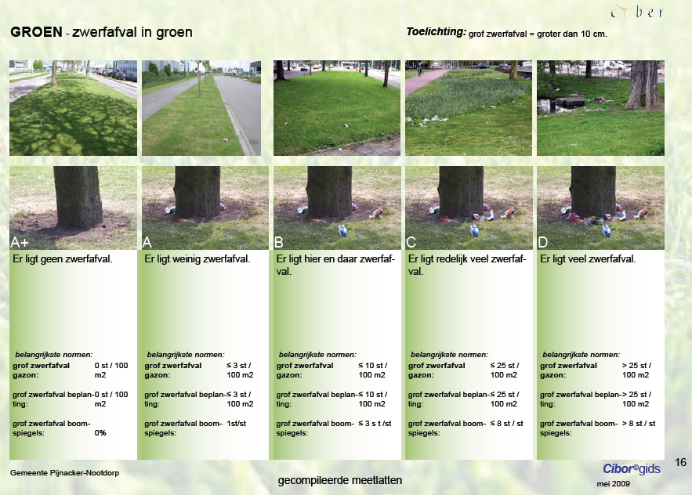

Slide 12
On the ground: maintenance standards – Emmen, Netherlands
Maintaining the maintenance standards
Evaluation on the field using ruler and PDA
Done by municipality
Cutback in financial resources and resulting lower standards is discussed again with inhabitants

Slide 13
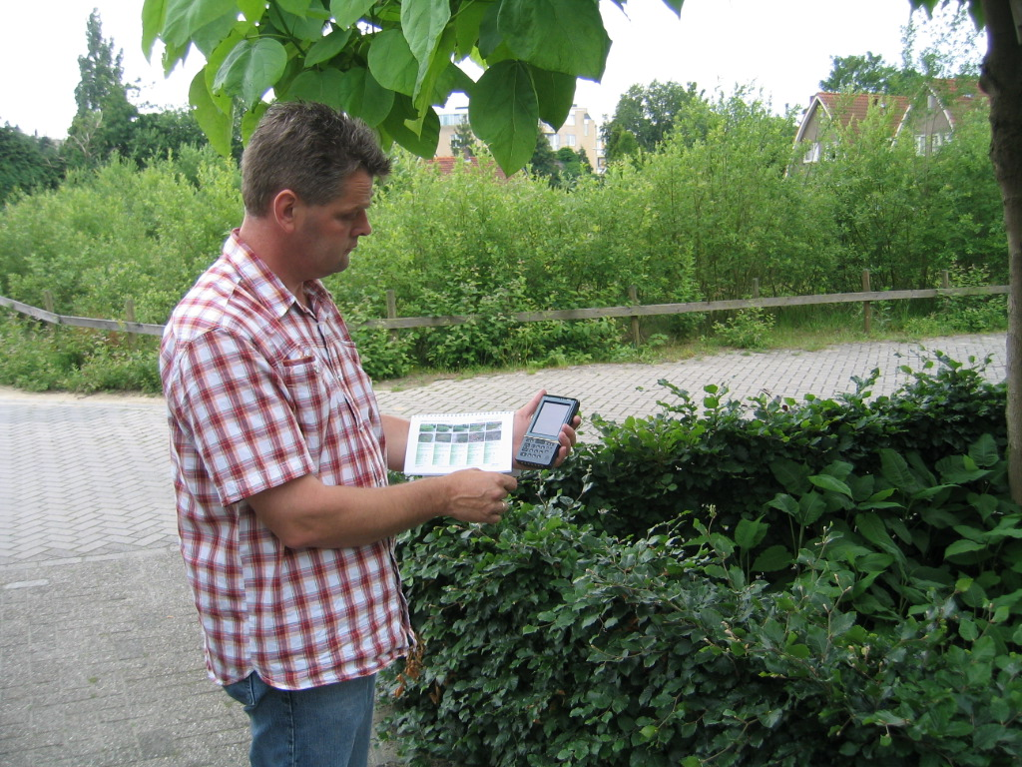

Slide 14
On the ground: maintenance standards – Emmen, Netherlands
Maintaining the maintenance standards
Evaluation on the field using ruler and PDA
Done by municipality
Cutback in financial resources and resulting lower standards is discussed again with inhabitants

Slide 15
On the ground: maintenance standards – Emmen, Netherlands
Use before investment:
Define level of maintenance, including budget
Use of imagery = common language with non-experts
Use after investment:
Tool to monitor the actual quality
Place keeping efforts can be adjusted to agreed level of maintenance

Slide 16
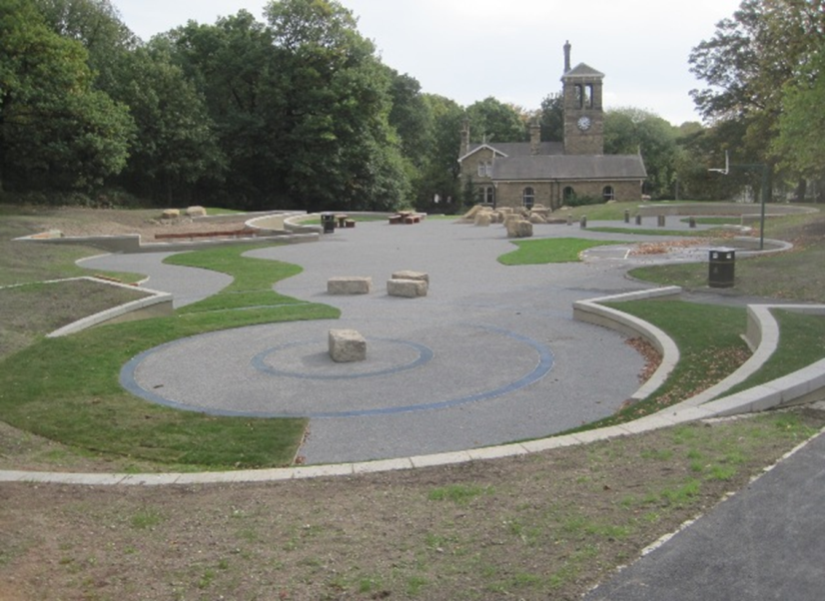
Process: mapping community capacity - Sheffield, UK
MP4 pilot example: Firth Park – Ripples in the pond
Objectives: To provide new recreational facilities, opportunities and experiences through creating a new community wetland area, natural play opportunities, an amphitheatre for local events, new accessible paths and new seating.

Slide 17
Process: mapping community capacity - Sheffield, UK
Firth Park has a strong community to support place making and place keeping: Friends of Firth Park: voluntary residents’ organisation with interest in local park
The group has worked with Sheffield City Council for many years, and was involved in the decision-making around the redevelopment of a derelict pond in the park to provide a multipurpose area.
Evaluation of community capacity is important, because it provides an insight into how an investment in green infrastructure is or can be embedded within the local community

Slide 18
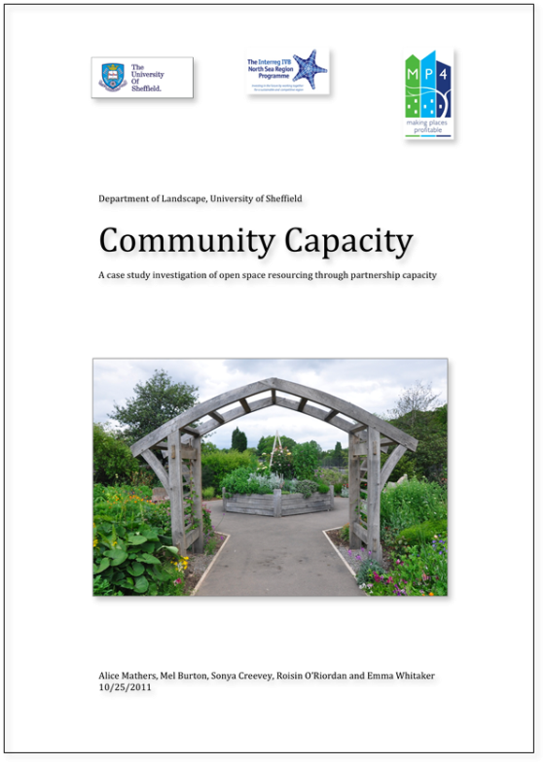
Process: mapping community capacity - Sheffield, UK
How to evaluate:
defining six dimensions of community capacity
Based on interviews with responsible people
Six dimensions of capacity:
Capital
Commitment
Skill Base
Motivation
Communication
Political Influence

Slide 19
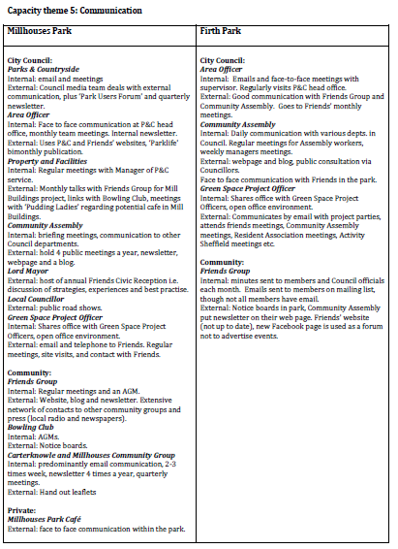
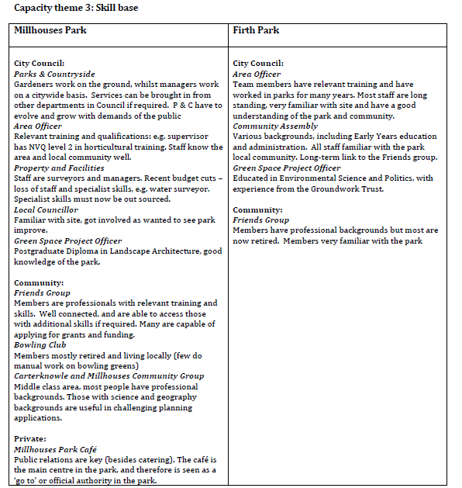
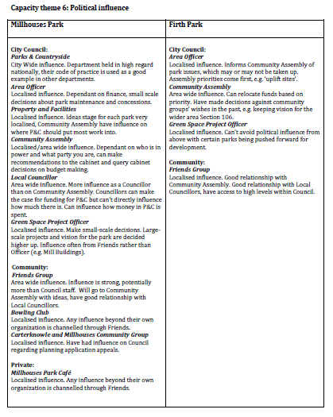
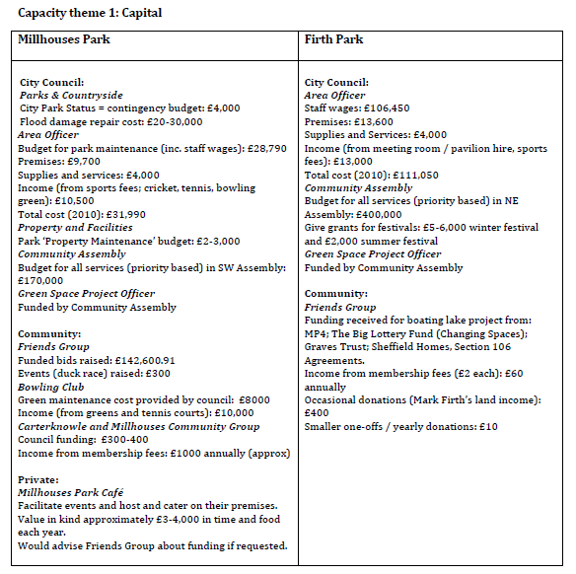
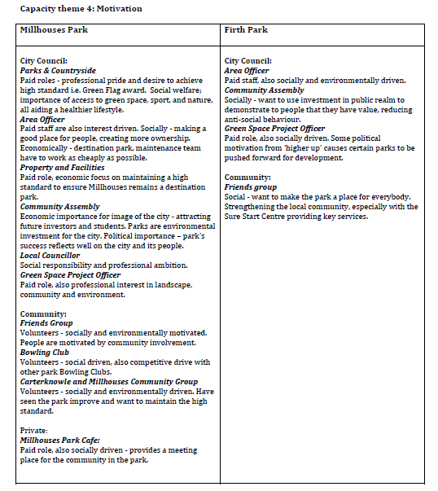
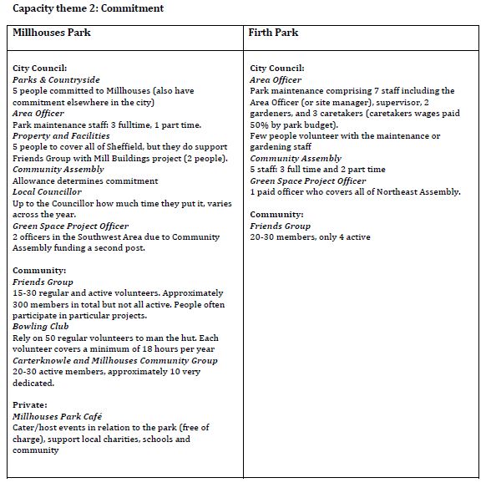
Process: mapping community capacity - Sheffield, UK

Slide 20
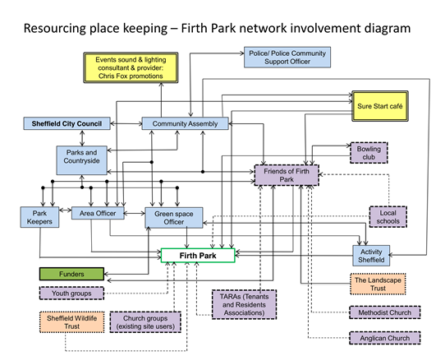
Process: mapping community capacity - Sheffield, UK
The associated importance of (organisational & social) network connections was also revealed
How: construction of network diagrams based on interview feedback + detection of importance of various partners within the network
Results:
Interesting partnership alliances can be found
potential alliances can be determined

Slide 21
Process: mapping community capacity - Sheffield, UK
Use before investment:
a tool to evaluate risks and opportunities of local community on the short term (place making issues)
Use after investment:
a tool to evaluate risks and opportunities of local community on the long term (place keeping issues)
Use apart from investments:
By Friends Groups: to guide and sustain their future development
By city council: to understand how Friends groups work, how they can support the development of sites and how they should be supported to do so

Slide 22
Process: Village-wide evaluation – Emmen, Netherlands
MP4 pilot example: Emmen Revisited (ER), a joint-venture between Municipality and Housing Corporations aiming to improve the social and living environment in urban districts and villages.
In the small village of Barger Compascuum, ER worked with local community in a structured approach to establishing community representative bodies which were involved in decisions around the design of the redeveloped village centre pedestrian-friendly shared space.
The success in the place-making stage has led on to continuing collaboration between the community representative body and ER in establishing a joint place-keeping group.

Slide 23
Process: Village-wide evaluation – Emmen, Netherlands
Evaluation of place-making was carried out jointly by specialists and residents at several points during the process.
Evaluation will take place again with the same group, after the project site has been used for several months.
In the meetings between the community representative body and ER the process to establish appropriate place-keeping arrangements is continuously monitored and evaluated through discussion.
Harry & Filip can provide more detail as info was collected during evaluation visit in April.

Slide 24
Several approaches in evaluation (4): Generic feedback from our pilots
Returning to the question of ‘How can the valuation and evaluation of open space contribute to its long-term management?’ these MP4 pilot project experiences demonstrated several potential ways of doing this, but the project also showed that, on a generic level, among agencies involved the following prevails:
Evaluation is mostly understood as a look at results not at processes
Envisaged techniques tend to be footfall surveys, user surveys, statistics on crime and vandalism, photo documentations, interviews
Ex-post evaluation instead of ongoing evaluation and monitoring
Evaluation in a sense of talking together (between policy, administration and community) is evolving
Evaluation from transnational partners (within the MP4 project) is seen as useful
Overall, there tends to be very little evaluation beyond the usual measures needed for funding requirements, and very little ongoing monitoring / evaluation beyond life of project/grant funding
Given the benefits of evaluation, how can barriers be overcome to ensure more widespread valuation & evaluation of open space that contributes to it its long-term management?

