Slide 1
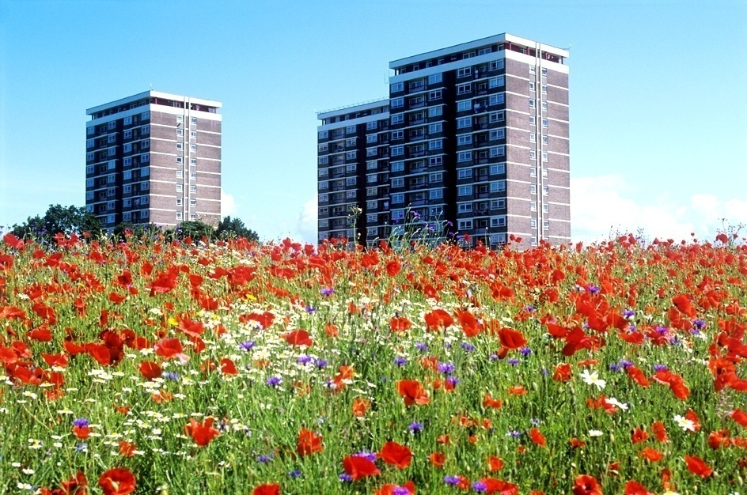
Good Afternoon
Dr Sidney Sullivan
SGS
Environmental & Management
Consultancy
England

Slide 2


Green Growth: New Shoots
10th May 2012
Policy and Planning – An external view

Slide 3
Delivering Quality Landscapes & ‘Place’
The Policy & Planning Context within
a
Political Economy

Slide 4
The Art of Socio Landscape Management

Slide 5
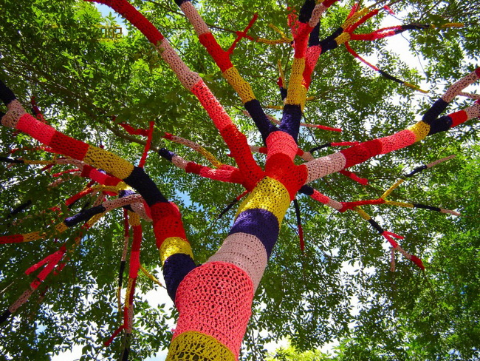
Overview of the UK Sector
Parks, Approx 12% of the
UK’s land mass
More than 300 Parks Services
More than 32,000 Parks and
Open Spaces
Budget £640,000,000m - 3/4 of
a billion £s pa
  The multiplier
  93,000 employees in UK
RSLs, manage approx 3% of
UK’s land mass
8.5 million residents
Visitor numbers
  Parks 3 billion per annum
  RSLs, 17m people per
  day, 119m per week!

Slide 6
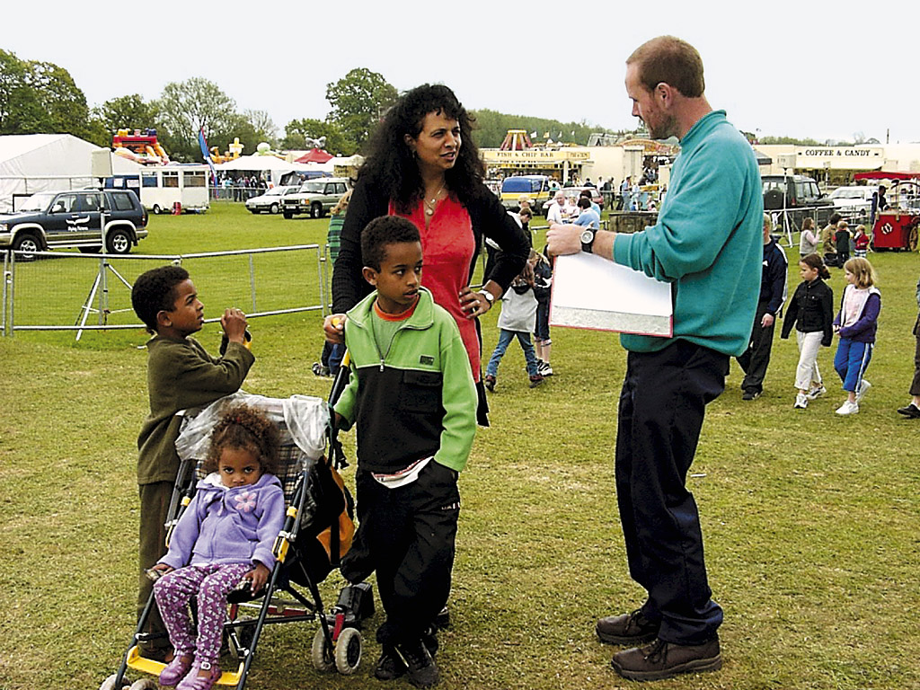
People, not Customers . . .

Slide 7

It is a juggling act

Slide 8
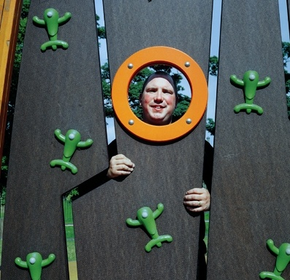
Overview of Approach
Coordination of Strategic & Operational practice!
The Journey is as important as the destination
Engagement
Local Variations
Peer Reviewed Research
Joint Advocacy & Marketing
Quality Assure Partnerships/Alliances

Slide 9
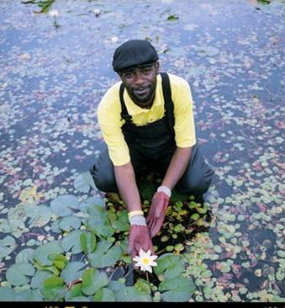
Economic and Societal Value
Make it Visible?
People
  multi-cultural
  values and norms
  Require a
  strong
  engagement
  ethos
Life-Style &
‘Place’

Slide 10
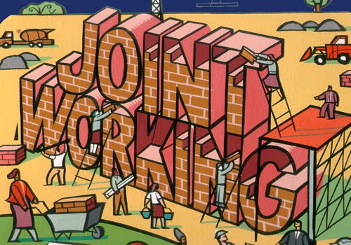
Partnerships & Alliances

Slide 11
The Challenge
To be ‘smart’
“Be wary of partners who are more interested in extracting your resources than in building your capacity”
Hillary Clinton, Financial Times 1 December 2011

Slide 12
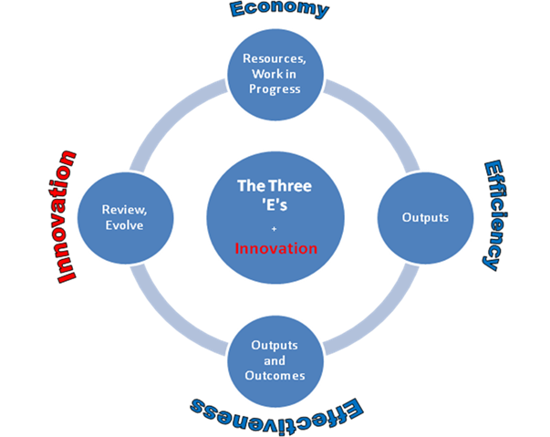
The Essence of ‘Green Shoots’

Slide 13

Economic and Social Challenges
The power of
‘volunteerism’
Joint advocacy will
displace a single channel
professional ‘voice’
Discussion not referenda
    Shorter product and practice ‘life cycles’
    CLERE Model (Barber, 2005)
    No perfect knowledge

Slide 14
How we can improve the current policy framework for place-keeping?
Strategy into
Practice
Evidenced
Supported
Practice
“Capacity Building”
A Culture of
Continuous
Improvement
Affordable
Outcomes

Slide 15
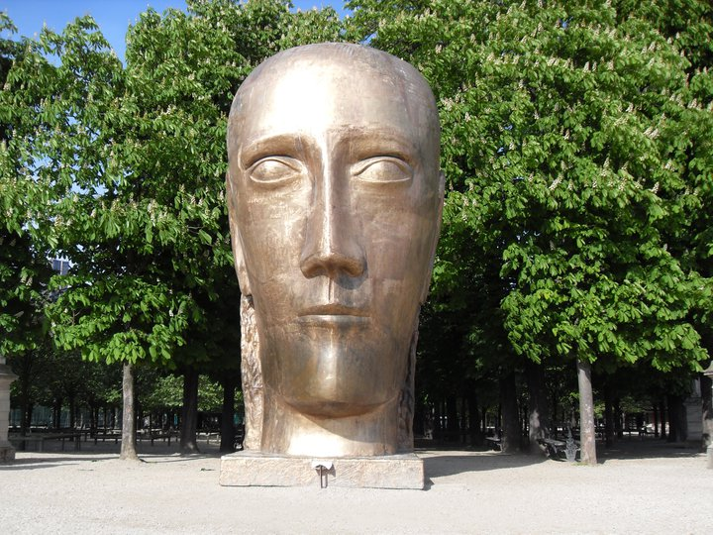
Imagine a new ‘Green Shoots Future’ . . .
Thank you . . .
Le Prophète

