Slide 1
Valuation & evaluation: How can the valuation and evaluation of open space contribute to its long-term management? Lessons from MP4
Green Growth: New Shoots
10th May 2012
Filip Sosenko
Heriot-Watt University

Slide 2
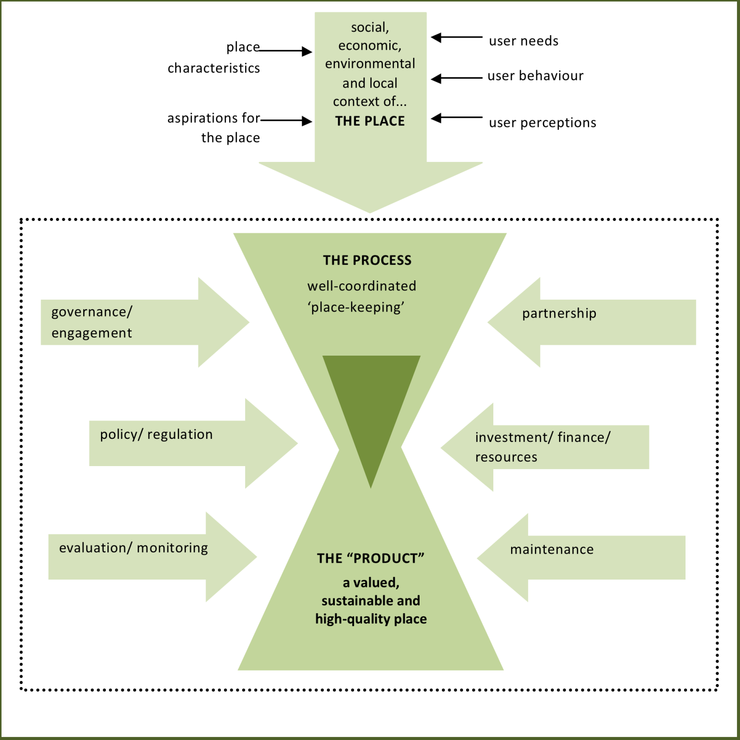
Place-keeping:
Place
Process
Product

Slide 3
Evaluation – What is it?
An assessment based on systematic collection & analysis of data (quantitative or qualitative) in order to aid decision-making.
Not an ‘academic’ exercise but a tool to improve processes and results, and in effect to improve public spending or save public money.
Prerequisites for evaluation & monitoring: evaluation strategy, methodology, instruments, and resources

Slide 4
Importance of robust evaluation of place-keeping
Open spaces and their maintenance are often evaluated intuitively by residents, visitors, business, media, etc. potentially influencing:
business location decisions,
property prices
visitor satisfaction and numbers
overall image of a place
feelings of safety…
This can have social and economic consequences for an area, and may have political significance.

Slide 5
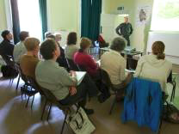
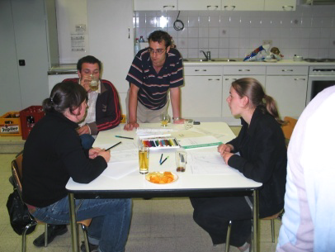
How can it be applied to place-keeping of open space?
(1) Evaluation/monitoring of place-keeping process :
How are place-keeping activities developed?
Who makes important decisions?
Is it clear who has what role and responsibility for?
Are decision-makers accountable?
Are all potential participants involved?

Slide 6
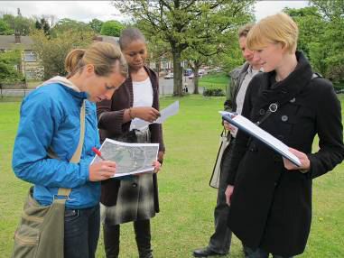
How can it be applied to place-keeping of open space?
(2) Evaluation of place-keeping results:

Slide 7
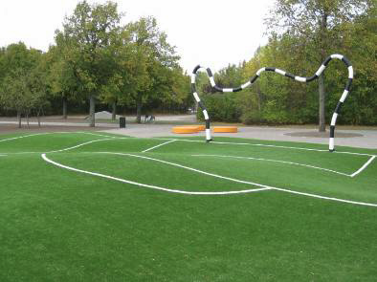
How can it be applied to place-keeping of open space?
(2) Evaluation of place-keeping results:
Is the place well-maintained?

Slide 8
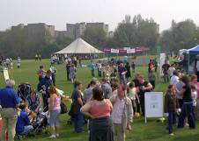
How can it be applied to place-keeping of open space?
(2) Evaluation of place-keeping results:
Is the place well-maintained?
Is the place well-used?

Slide 9
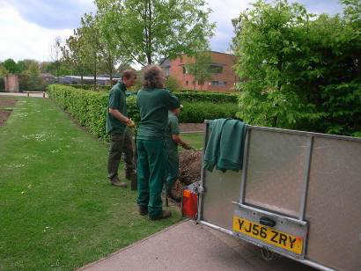
How can it be applied to place-keeping of open space?
(2) Evaluation of place-keeping results:
Is the place well-maintained?
Is the place well-used?
Have local people involved in PK benefited from this involvement (e.g. in terms of wellbeing, sense of ownership, etc)? Has the wider local community gained from the place being well kept up and used (e.g. increased local sense of identity, less vandalism, etc)?

Slide 10
How to ‘measure’ place-keeping?
Appropriate measurement of place-keeping is difficult. Many indicators measure:
quality of open space rather than place-keeping itself
results of place-keeping rather than the process.
A number of indicators widely used in measuring quality of open & green spaces can be used in the measurement of place-keeping (as process and as product): awards, competitions, user satisfaction surveys, surveys of public space use, etc.
How can less tangible aspects of place-keeping such as local sense of identity and wellbeing be measured?

Slide 11
Approaches & considerations
Objective or subjective measurements.
‘Quality’ is often a subjective matter!
External/professional or user evaluation.
Ongoing or a one-off measurement (during the process or ex-post).

Slide 12
Over to Pieter!

Slide 13
Valuation & evaluation: How can the valuation and evaluation of open space contribute to its long-term management? Experiences from MP4 pilot projects
Green Growth: New Shoots
10th May 2012
Pieter Vercammen
Vlaamse Landmaatschappij - VLM

Slide 14
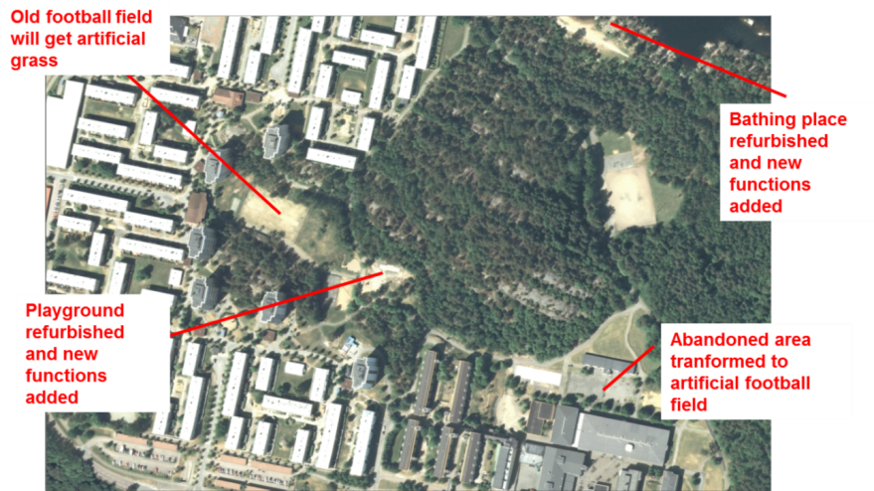
On the ground: establishing a baseline through Sociotope mapping - Gothenburg, Sweden
MP4 pilot example: Lövgärdet and Eriksbo
two housing estates from the 1960s and 1970s with under-used adjacent nature areas (lake and green spaces).
Mostly occupied by a deprived community.
Objective: renew the physical environment in a sustainable manner, encouraging socio-economic growth and long-term improvements to increase the attractiveness of open space.

Slide 15
On the ground: establishing a baseline through Sociotope mapping - Gothenburg, Sweden
Gothenburg Sociotope mapping
background information which was used in the overall analysis of the park’s situation within the city.
Mapping user preferences, qualities and weaknesses in the green structure.
How?
User surveys, discussion panels, site observations, interviews with residents and people working in the area
Questions: frequency of visits, indicate importance of sites, purpose of visit…
Integration of all that information into one sociotope map

Slide 16
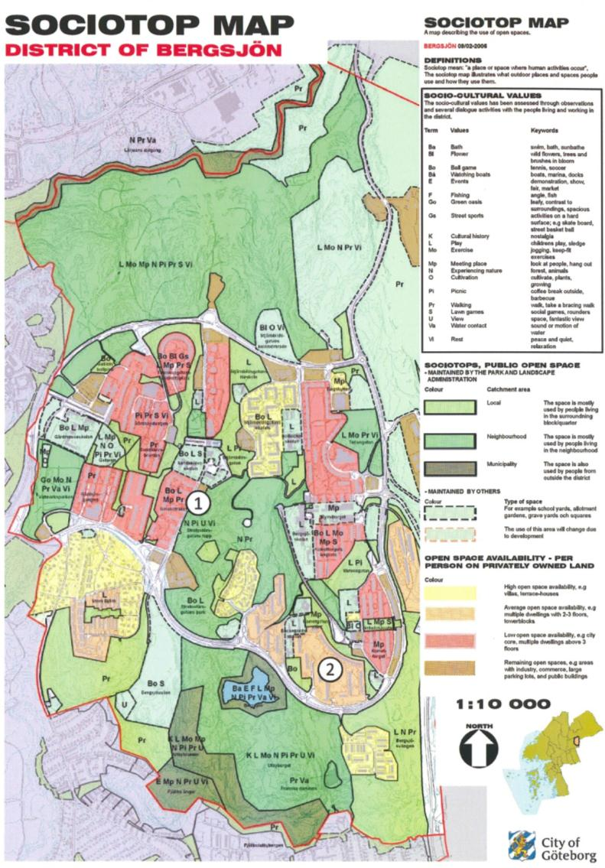
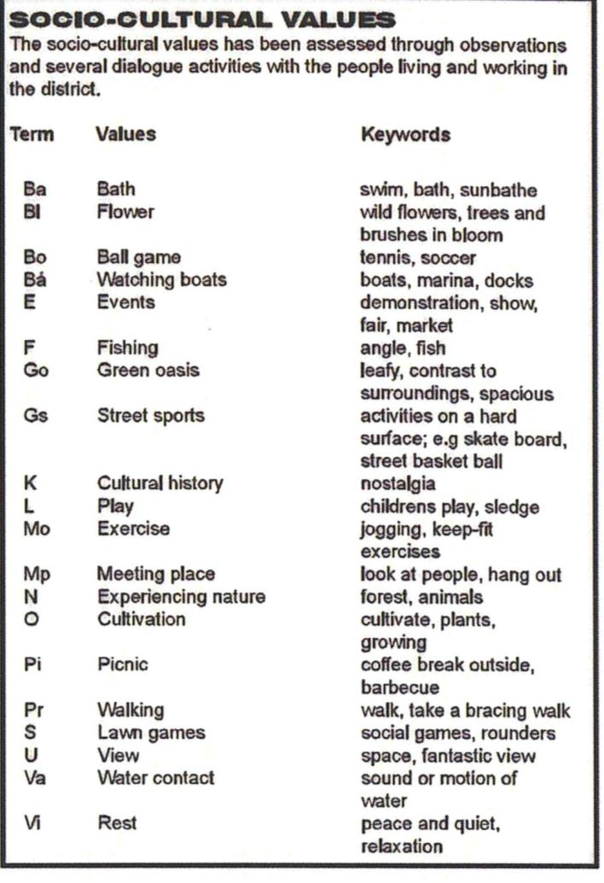
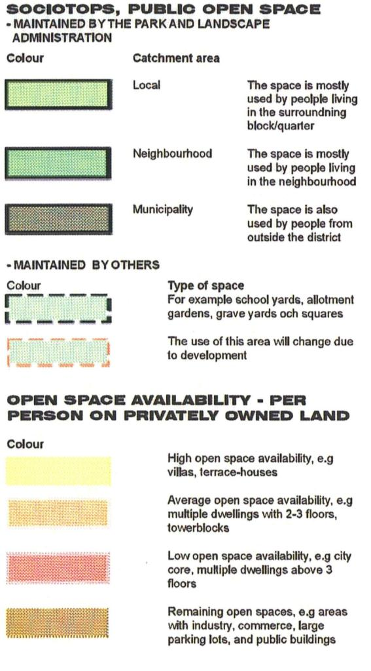
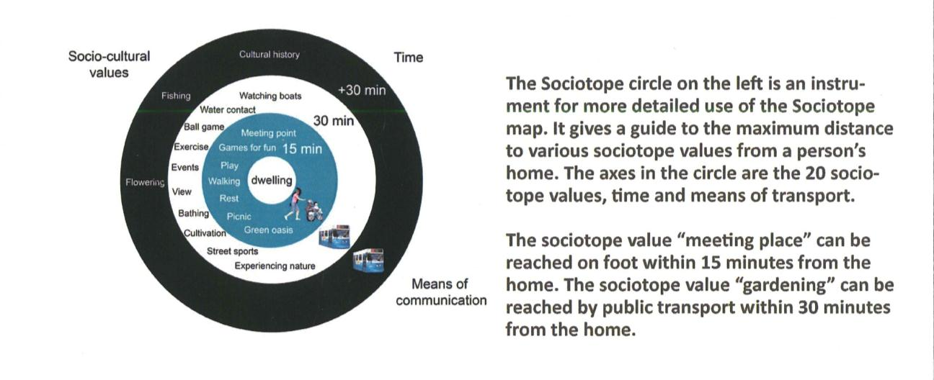

Slide 17
On the ground: establishing a baseline through E-mapping - Gothenburg, Sweden & Sheffield, UK
E-mapping builds on the sociotope methodology
Building a layer with
Recreational experiences (memorable personal sensation)
Recreational zones
Recreational potentials
How
Interviews with user groups, surveys
What can it be used for
Site analysis
Identification of improvement potentials
Valuation of recreational value and quality

Slide 18
On the ground: establishing a baseline through Rec-mapping - Gothenburg, Sweden & Sheffield, UK
Mapping recreational experience in eight dimensions
EXPERIENCES IN RECREATIONAL GREEN-SPACES
NAME | SHORT DEFINITION / INTERPRETATION | IMPORTANT CHARACTERISTICS/ACTIVITIES
NATURE | Sensation of the free growing, untouched, vital, an encounter with nature on its own conditions. | No visible man-made facilities or traces, no visible or audible urbanity. ‘Nature areas’.
RICHNESS IN SPECIES | Sensation of richness in plants, insects and/or animals. | Presence of different or special plants, flowers, insects and/or animals. Possibility to gather mushrooms, fruits etc.
SERENE | Sensation of an undisturbed peacefulness, to be on one’s own, in safety and withdrawn in one with nature/surroundings. | No artificial noise (e.g. transport), few or no other humans, no garbage, no paths/transport corridors.
SPACE | Sensation of an independent, inter-connected and special ’universe’. | No cross-cutting paths or disturbing features. At least two types: A ‘hall of old beech trees’ or ‘an open horizon’ at a lake/the sea.
REFUGE | Sensation of safe and provided surroundings and facilities for expression, play and interactions with other people. | Demarcated and uncluttered space/place by trees, bushes, fences. Play facilities, tables/benches, meet animals. ‘Play ground’
PROSPECT | Sensation of open and free surroundings for expression and activity. | Open and accessible space with grass/sports fields / gravel fields. Supporting facilities such as light, changing rooms. ’The common’
SOCIAL | Sensation of organized and entertaining scene and get together with other people. | Provided and arranged facilities, services, activities, café, restaurants, benches, tables, barbeque and entertainment. ’A social scene’.
CULTURAL | Sensation of cultivated, man-made surroundings formed by history and culture. | Historical features and buildings, Sculptures, statues, fountains, canals, flower stands, well-cut bushes, formal elements. ‘Historical city park’.
Mapping of strength: 0: not present, 1: weak experience, 2: good experience, 3: a full experience

Slide 19
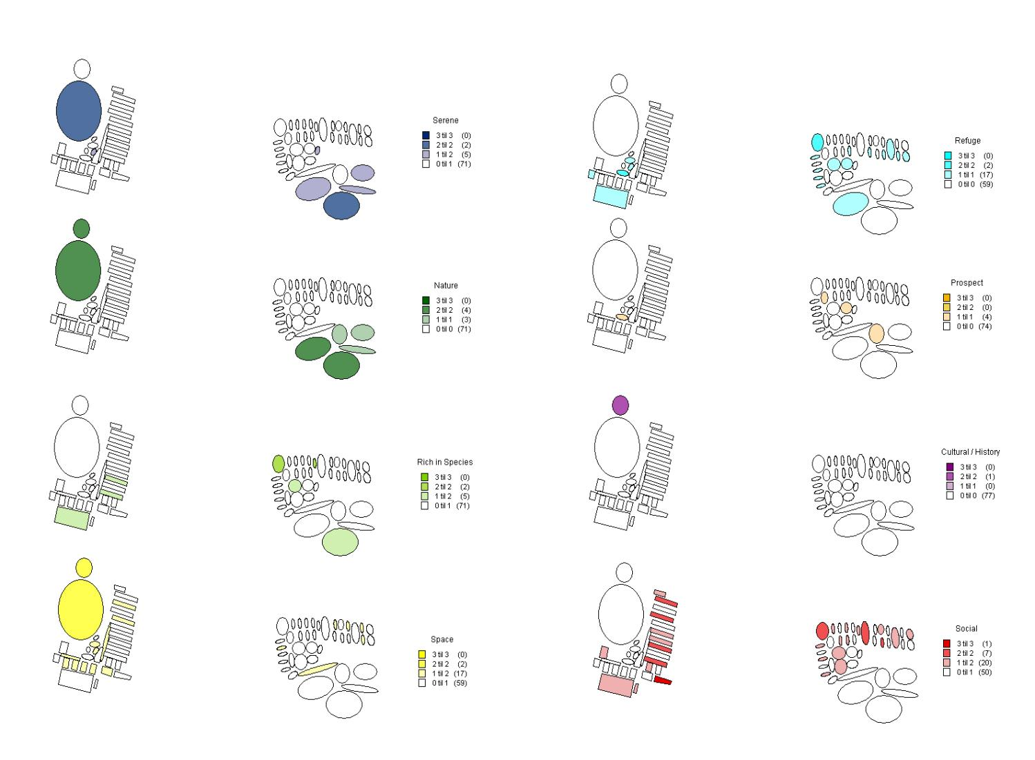
On the ground: establishing a baseline through Rec-mapping - Gothenburg, Sweden

Slide 20
On the ground: establishing a baseline through Sociotope and E-mapping
Use before investment:
Choose most profitable places for investments
Present ideas about how to direct the development of these places
Use after investment:
Tool to monitor the actual use and functionality
Place keeping efforts can be adjusted to actual use

Slide 21
On the ground: maintenance standards – Emmen, Netherlands
Setting the maintenance standards: use of visual rulers
Example: municipality Emmen
Emmen is responsible for maintenance of public (green) spaces
Five levels of maintenance A+, A, B, C, D
Maintenance on demand / image driven
Level of maintenance is
Agreed in discussion with inhabitants and municipality using a visual ruler
Dependent on available funding within municipality
Dependent on site type (sports park, residential area, commercial centre…)

Slide 22
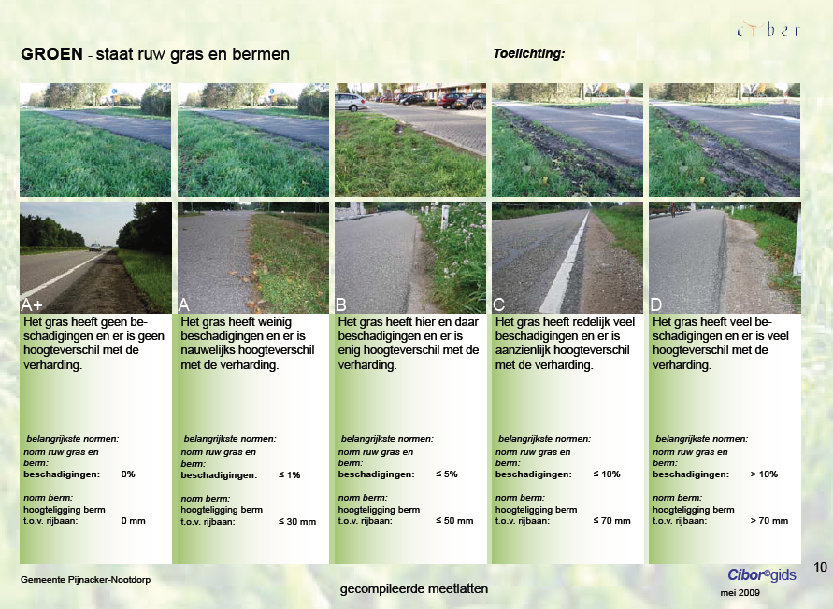

Slide 23
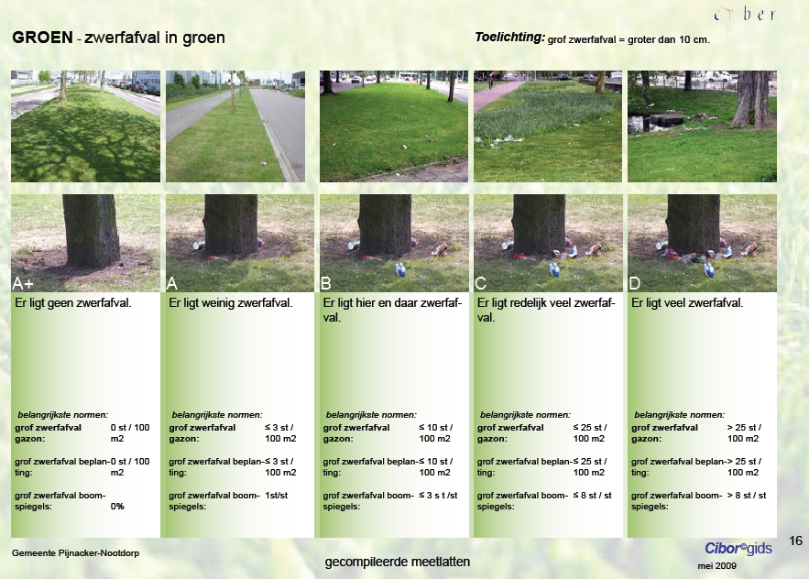

Slide 24
On the ground: maintenance standards – Emmen, Netherlands
Maintaining the maintenance standards
Evaluation on the field using ruler and PDA
Done by municipality
Cutback in financial resources and resulting lower standards is discussed again with inhabitants

Slide 25
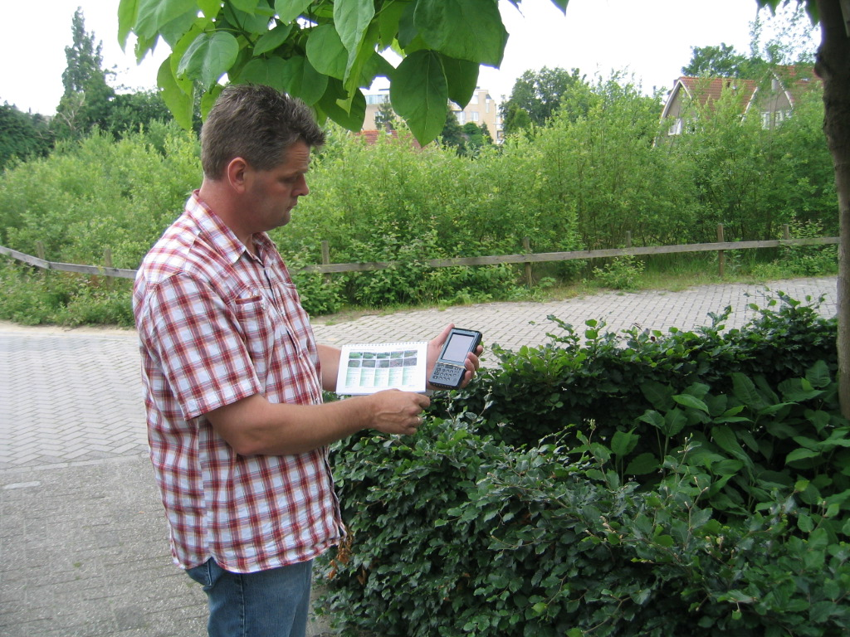

Slide 26
On the ground: maintenance standards – Emmen, Netherlands
Maintaining the maintenance standards
Evaluation on the field using ruler and PDA
Done by municipality
Cutback in financial resources and resulting lower standards is discussed again with inhabitants

Slide 27
On the ground: maintenance standards – Emmen, Netherlands
Use before investment:
Define level of maintenance, including budget
Use of imagery = common language with non-experts
Use after investment:
Tool to monitor the actual quality
Place keeping efforts can be adjusted to agreed level of maintenance

Slide 28
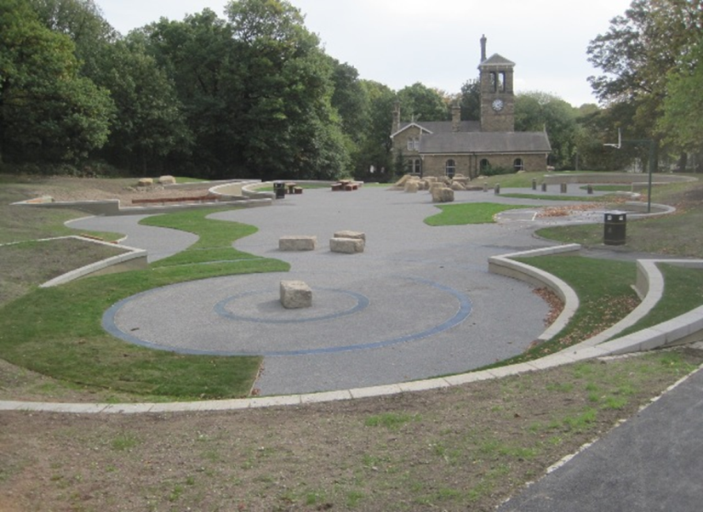
Process: mapping community capacity - Sheffield, UK
MP4 pilot example: Firth Park – Ripples in the pond
Objectives: To provide new recreational facilities, opportunities and experiences through creating a new community wetland area, natural play opportunities, an amphitheatre for local events, new accessible paths and new seating.

Slide 29
Process: mapping community capacity - Sheffield, UK
Firth Park has a strong community to support place making and place keeping: Friends of Firth Park: voluntary residents’ organisation with interest in local park
The group has worked with Sheffield City Council for many years, and was involved in the decision-making around the redevelopment of a derelict pond in the park to provide a multipurpose area.
Evaluation of community capacity is important, because it provides an insight into how an investment in green infrastructure is or can be embedded within the local community

Slide 30
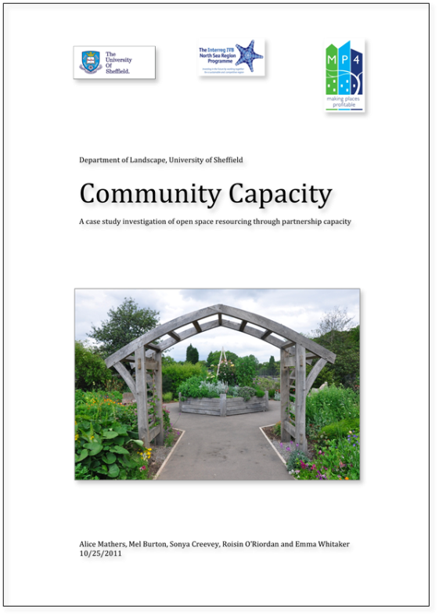
Process: mapping community capacity - Sheffield, UK
How to evaluate:
defining six dimensions of community capacity
Based on interviews with responsible people
Six dimensions of capacity:
Capital
Commitment
Skill Base
Motivation
Communication
Political Influence

Slide 31
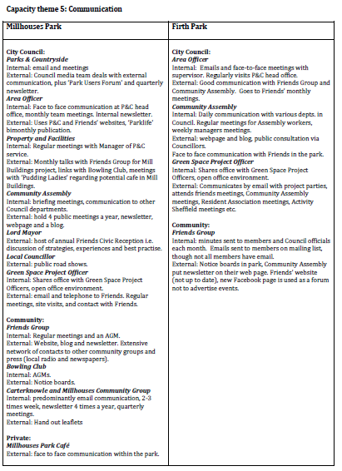
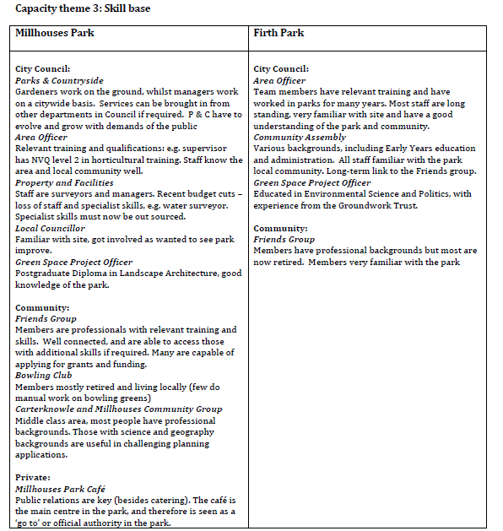
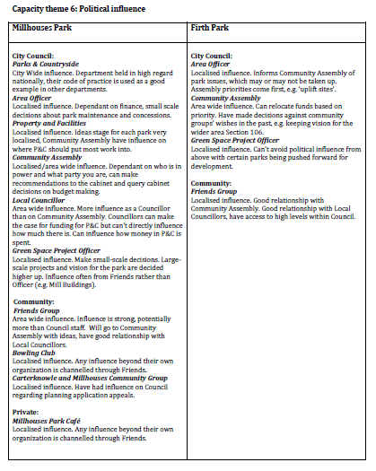
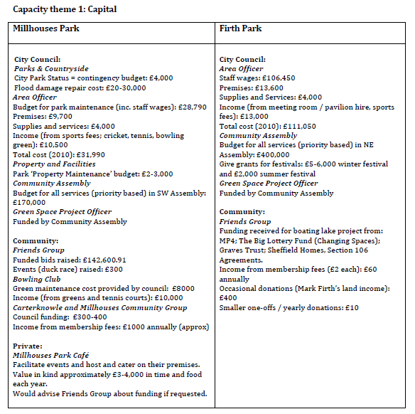
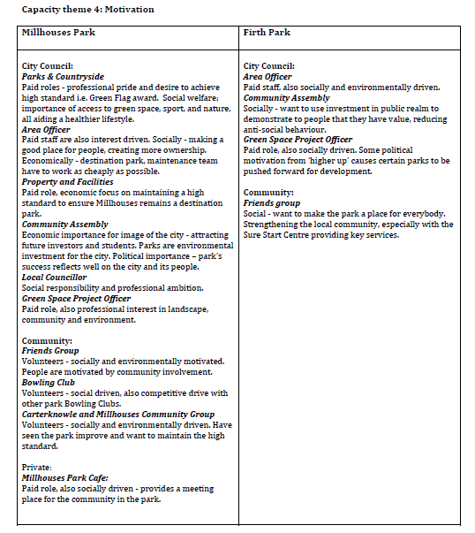
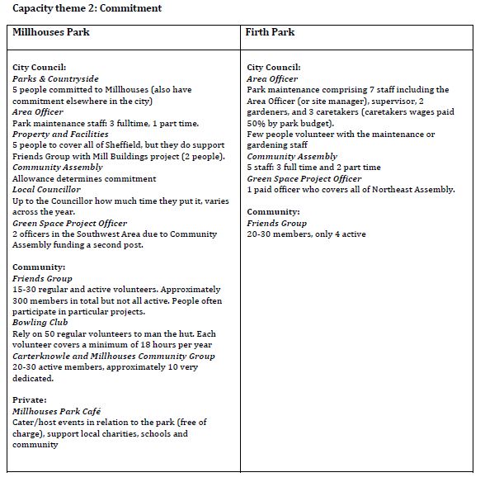
Process: mapping community capacity - Sheffield, UK

Slide 32
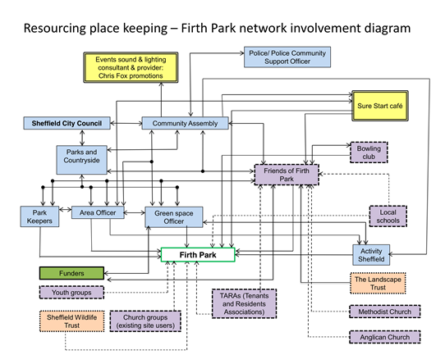
Process: mapping community capacity - Sheffield, UK
The associated importance of (organisational & social) network connections was also revealed
How: construction of network diagrams based on interview feedback + detection of importance of various partners within the network
Results:
Interesting partnership alliances can be found
potential alliances can be determined

Slide 33
Process: mapping community capacity - Sheffield, UK
Use before investment:
a tool to evaluate risks and opportunities of local community on the short term (place making issues)
Use after investment:
a tool to evaluate risks and opportunities of local community on the long term (place keeping issues)
Use apart from investments:
By Friends Groups: to guide and sustain their future development
By city council: to understand how Friends groups work, how they can support the development of sites and how they should be supported to do so

Slide 34
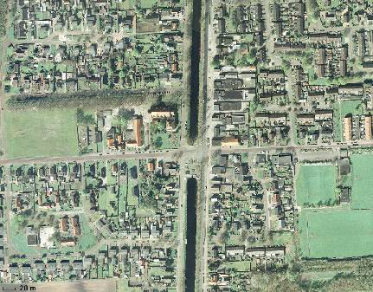
Process: Village-wide evaluation – Emmen, Netherlands
MP4 pilot example: Emmen Revisited (ER) – joint-venture between Municipality and Housing Corporations aiming to improve the social and living environment in urban districts and villages.
In Barger Compascuum (small village) , ER worked with local community in a structured approach to establish community representative bodies involved in decisions on redeveloping the village centre into a pedestrian-friendly shared space.
Evaluation of place-making jointly by specialists and residents at several points during the process, including with the mayor and aldermen. On-going evaluation contributes to positive feedback/communication.
Evaluation will take place again with the same group, after the project site has been used for several months.

Slide 35
Process: Village-wide evaluation – Emmen, Netherlands
In the meetings between the community representative body and ER the process to establish appropriate place-keeping arrangements was continuously monitored and evaluated through discussion.
Eventually the success in the place-making stage has led on to establishing a joint maintenance/management (place-keeping) group:
2 representatives from the Village Council (residents)
1 person from social organisation in charge of unemployed
1 member of the Maintenance Department from the Municipality.
The group meets every 2 months and decides who does what on the basis of complaints. It is an ongoing monitoring system for place-keeping, which generates a list of place-keeping tasks & responsibilities, intended to trigger actions.

Slide 36
Back to Filip!

Slide 37
Key findings from MP4 (1)
Monitoring & evaluation often takes lower priority in relation to capital investments, being limited to usual measures needed for funding requirements, and limited to the life of grant funding. This can be because:
Project Managers see it as too expensive; or
They do not see it as a particularly useful tool; or
Stakeholders may see evaluation as potentially threatening therefore putting off project managers from undertaking it
Monitoring & evaluation needs to be budgeted for at the beginning. Failure to do so will likely result in the opportunity to take a baseline measurement being missed, or even evaluation not being undertaken at all.
Evaluation is mostly understood as a look at results not at processes, hence a preference for ex-post evaluation instead of ongoing evaluation and monitoring.
Envisaged techniques tended to be: footfall surveys, user surveys, statistics on crime and vandalism, photo documentations, interviews

Slide 38
Key findings from MP4 (2)
The approaches used should depend on what the evaluation is for.
Usually fundamental to have: a baseline; a monitoring and evaluation plan from the beginning; relevant and integrated indicators.
Baselines are important to be able to measure against but not always directly applicable (e.g. where the transformation of the space and of its users is substantial, or where population may be transient).
Regular participatory evaluation can promote the space to users and engender community commitment.
Involving users can provide on-the-ground monitoring of open spaces for a limited cost. Extra support should be provided to users in this case.
If frequent or ongoing evaluation involving residents is set up, appropriate mechanisms or intervals need to be found to ensure that too much detailed input does not conflict with project development and delivery.

Slide 39
Key findings from MP4 (3)
In PK of open spaces evaluation can be used to: assist internal determination of priorities for action; ensure value for money; and reduce future costs.
Evaluating economic benefits of place-keeping is important but difficult. A distinction needs to be made between direct and indirect benefits and impacts.
Evaluation from transnational partners (within the MP4 project) is seen as useful
Qualitative evaluation can often be less highly regarded by public authorities, but can be a powerful tool to show real benefits (e.g. video interviews).
Given the benefits of evaluation, how can barriers be overcome to ensure more widespread valuation & evaluation of open space that contributes to it its long-term management?

Slide 40
Thank you!
Filip Sosenko, Heriot-Watt University
Pieter Vercammen, Vlaamse Landmaatschappij - VLM

